Slide 1
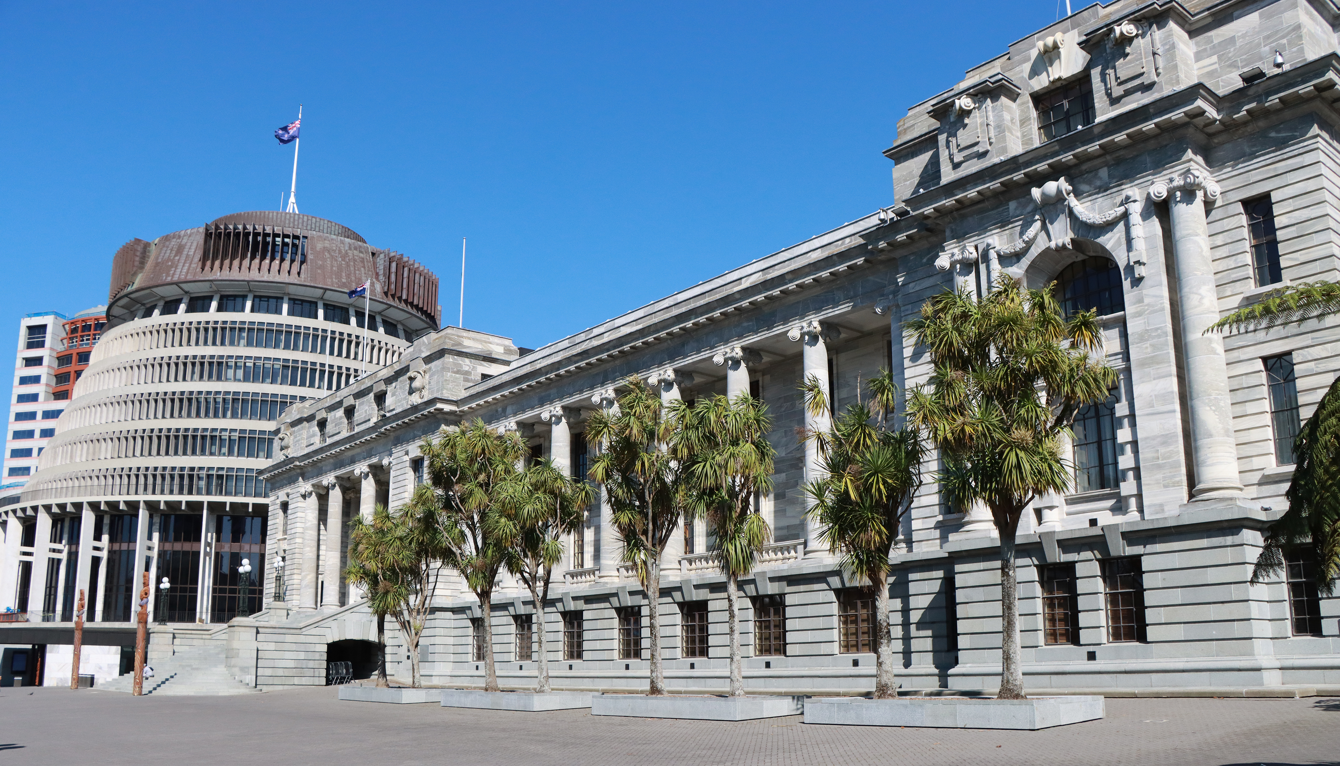
PANEL DISCUSSION
Engagement through social media
Rachel Tan – Waikato University
Dr Kit Kowol – Parliament of Queensland
Emma McAuliffe – NZ Parliament
Meredith Ross-James – Victoria University of Wellington
Facilitator: Amy Brier, Deputy Chief Executive
Library and Engagement
New Zealand Chapter
Notes:
`

Slide 2
Disrupting the disrupters: resilient parliamentary procedure and culture in an era of disruptive protest
Dr Kit Kowol, Assistant Committee Secretary, Queensland Parliament

Slide 3
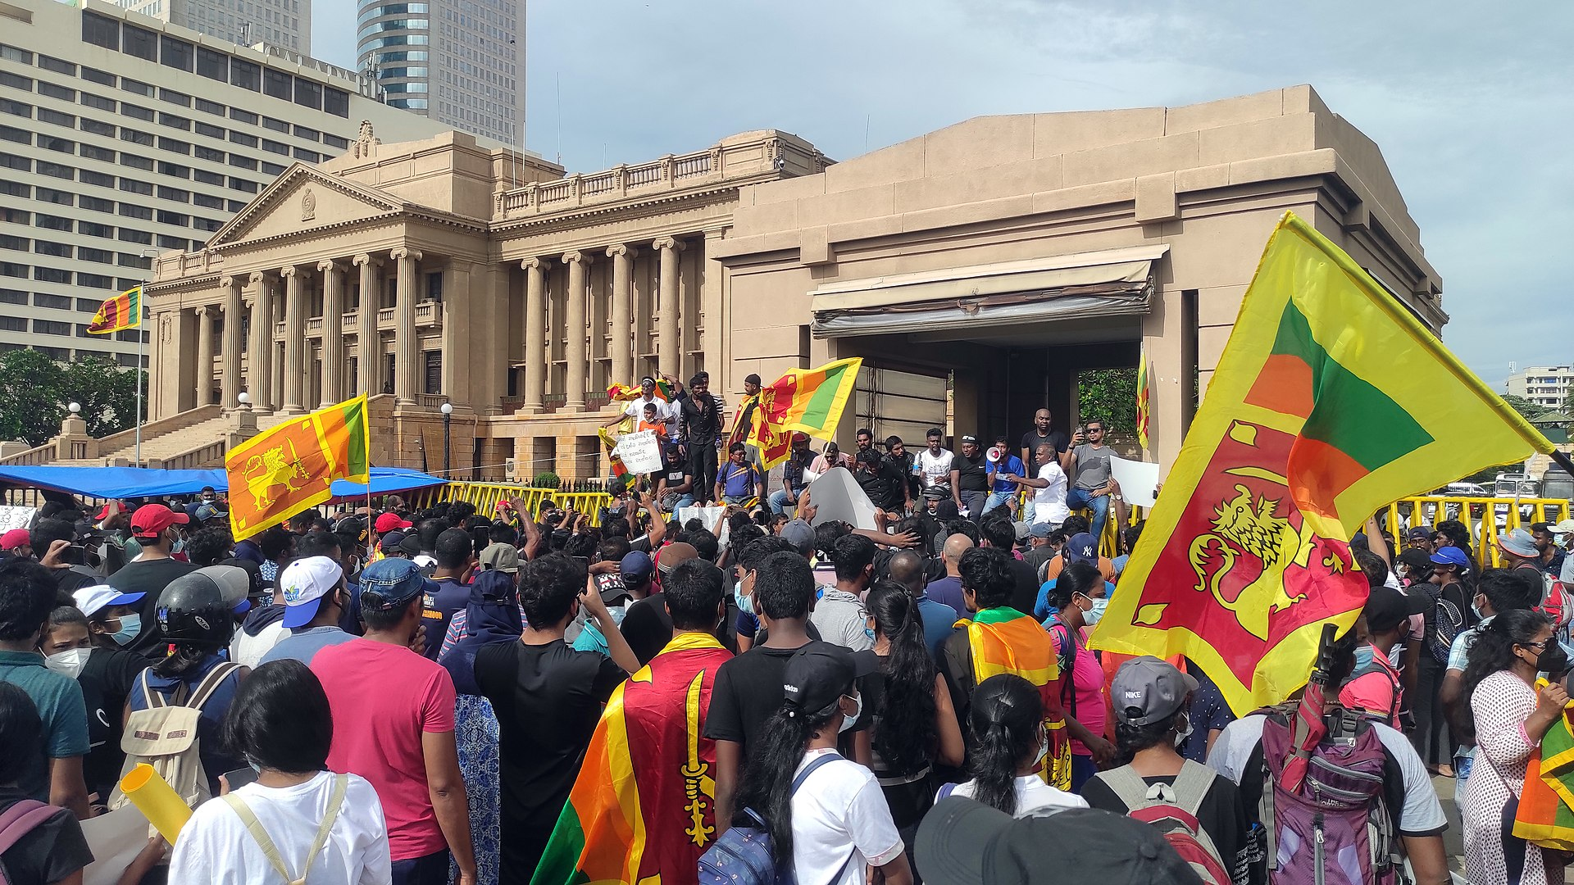
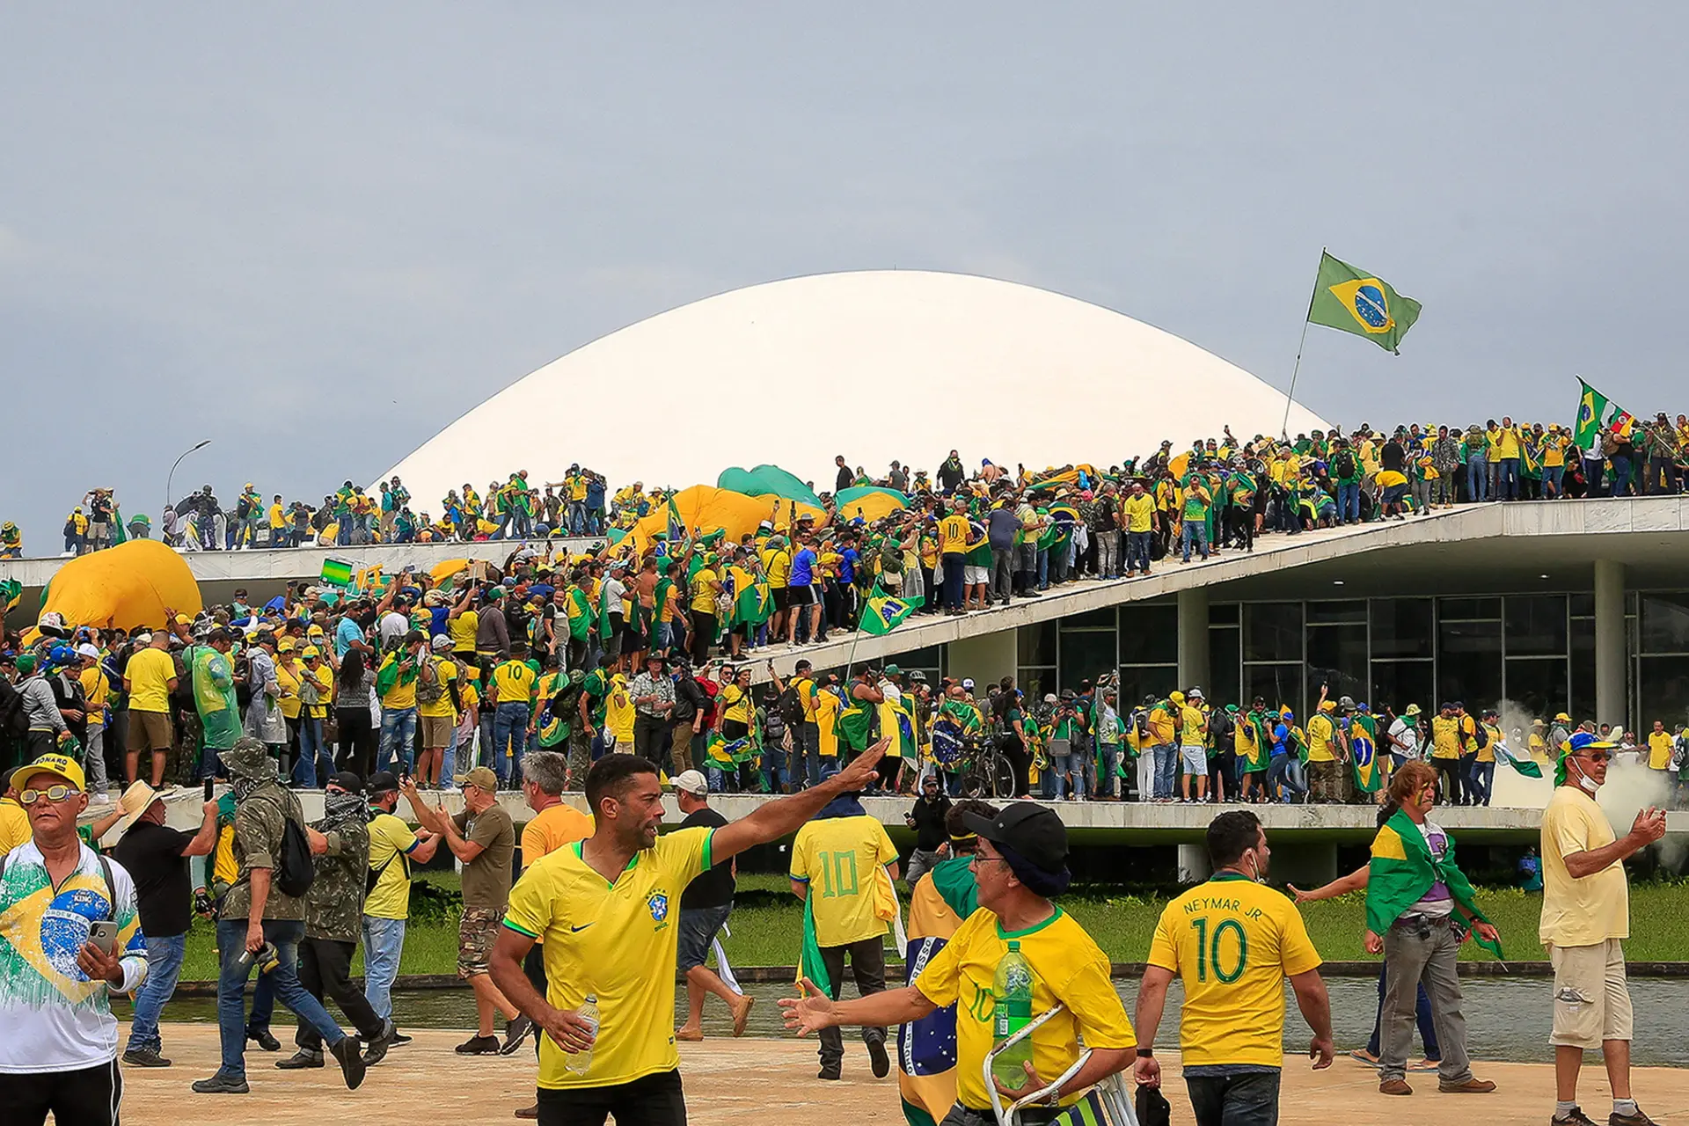
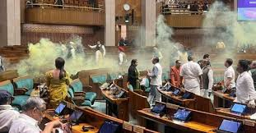
Disruptions

Slide 4
Disruptions

Slide 5
Queensland Legislative Assembly

Slide 6
So to those who took a stand today, I just want to say you are absolutely right. We need to stop coal and gas. And we need to keep saying it until the major parties start listening.

Slide 7
Queensland’s Standing Orders
SO 266. Examples of Contempt
Without limiting the power of the House, it may treat as a contempt any of the following:
…
(26) making public statements (either orally or in writing) inciting or encouraging disruption of the Legislative Assembly by bringing the proper proceedings of the Legislative Assembly or its committees into disrepute

Slide 8
Victorian Legislative Assembly

Slide 9
Courageous school strikers demanding an end to coal and gas and a safe climate future ❤️ Question time shut down and protestors removed by PSOs.
When the future of the planet is at stake, business as usual is no longer tenable

Slide 10
The Challenge to Parliament
Ubiquity, speed and reach of social media
Social media as mixed media
Punishment and the limits of deterrence

Slide 11
The Parliamentary Response
Balancing speed and attention
Naming and the right to free speech
The culture of procedure
Parliamentarians as social media experts
Precedent and reasoning by analogy
The educative effect
From education to sensation

Slide 13
Conclusion
Careful selection of method
Impartiality and avoidance of bias
The dignity of parliament

