Slide 1
PANEL DISCUSSION
Parliaments and artificial intelligence
Caitlin Connally, Inquiry Officer (Standing Committees) Parliament of Victoria
Dr Antonino Nielfi, Researcher
Parliament of Australia
Facilitator: Suze Jones, Deputy Clerk of the House
New Zealand Chapter
Notes:
`

Slide 2
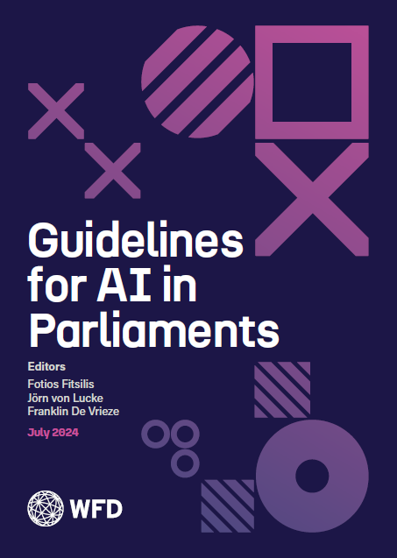
The Guidelines for AI in Parliaments
A project by the OCR Hellenic Team,
published by the Westminster Foundation for Democracy
Dr Antonino Nielfi,
Parliament of Australia
3 October 2024

Slide 3
Structure
Why do we need guidelines?
Development and attributes
Guideline section, 1 to 6
Translation and dissemination
Further development and improvements
Contact and disclaimer

Slide 4
Why do we need guidelines?
Ensure responsible AI Integration in parliamentary work
Promote consistency and standardization of AI practices across parliaments
Ensure ethical conduct in the use of AI
Help share best practices so that successful AI solutions can be reproduced in other parliaments and institutions
Align with democratic principles and societal needs promoting public trust in parliamentary processes

Slide 5
Development and attributes
40 guidelines grouped in 6 sections
Published by Westminster Foundation for Democracy
Developed by:
Hellenic OCR Team members
partner institutions and
international experts
22 parliamentary experts from 16 countries
Multi-disciplinary and cross-sector development
Download: https://www.wfd.org/ai-guidelines-parliaments

Slide 6
Guideline authors
Fotios Fitsilis, Hellenic Parliament
Jörn von Lucke, Zeppelin University
George Mikros, Hamad Bin Khalifa University
Monica Palmirani, University of Bologna
Alex Read, Chief Technical Specialist, UNDP
Günther Schefbeck, Parliament of Austria
Alicia Pastor y Camarasa, University of Lausanne
Stéphane Gagnon, Université du Québec en Outaouais
João Alberto de Oliveira Lima, Federal Senate of Brazil
Antonino Nielfi, Parliament of Australia
Georgios Theodorakopoulos, State Legal Council, GR
Marina Cueto Aparicio, Senado de España
Juan de Dios Cincunegui, Universidad Austral
Ari Hershowitz, Govable.ai
Ahto Saks, Parliament of Estonia
Jonas Cekuolis, expert on parliamentary development
Jonathan Ruckert, NovaWorks Australia
Elhanan Schwartz, Israel Ministry of Justice
Zsolt Szabó, Károli Gáspár Reformed Church University, Szechenyi Istvan University
Nicola Lupo, LUISS University
Marci Harris, POPVOX Foundation

Slide 7
Guidelines sectors
Ethical principles
Artificial general intelligence (AGI)
Privacy and security
Governance and oversight
System design and operation
Capacity building and education

Slide 8
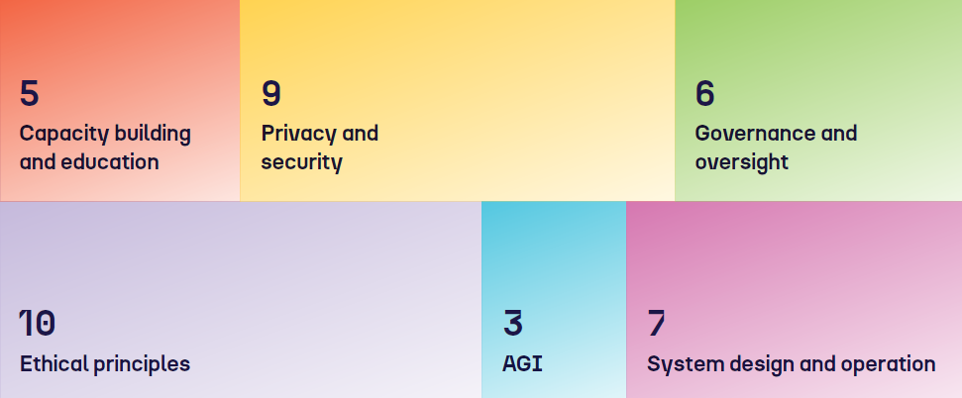
Number of guidelines per section

Slide 9
Ethical principles
Accountability and transparency
Respect for human dignity, rights, and privacy
Fairness, equity, and non-discrimination
Addressing biases in data and algorithms
Upholding intellectual property rights
Preservation of human values and cultural diversity
Evaluation and mitigation of unintended consequences
Public participation and engagement
Respect for the rule of law & democratic values
Promotion of policy goals

Slide 10
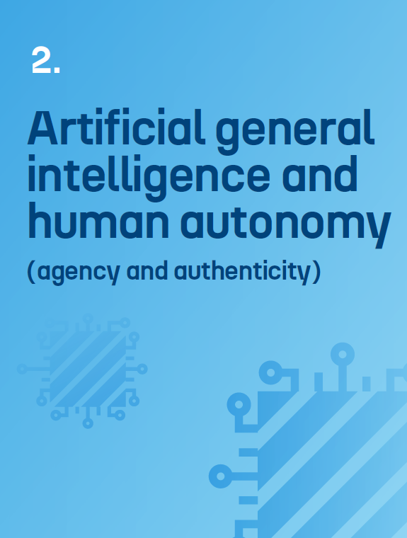
AGI and human autonomy
Promotion of human autonomy
Ethical requirements for designers and developers
Recognition of AGI as a real prospect

Slide 11
Privacy and security
Embedding safety and robust security features
Including privacy-by-design concepts
Secure processing of personally identifiable information
Outsourcing considerations
Consideration of data sovereignty issues
Ensuring the integrity of source material
Risk of overreliance on AI
Securing training and testing data
Human oversight in security decisions

Slide 12
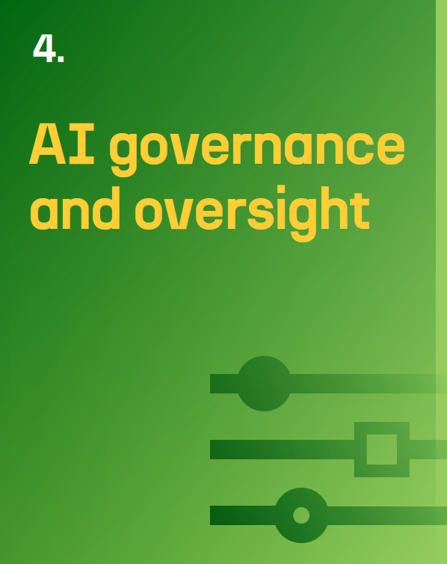
Governance and oversight
Integration into a broader digital parliamentary strategy
Efficient data governance and management protocols
Establishing a parliamentary ethical oversight body
Assessing the effects of parliamentary AI
Securing access to and control over the data
Cooperation with stakeholders

Slide 13
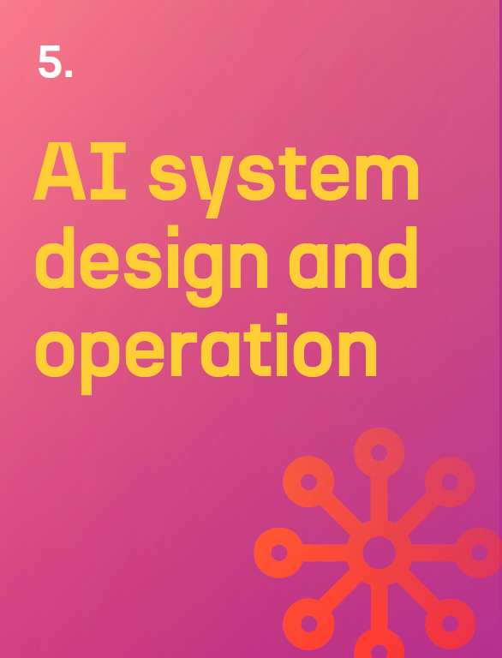
System design and operation
Implementing standardised data schemes and processes
Emphasising AI algorithms' explainability
Building robust and reliable AI systems
Regulating the use and deployment of AI systems
Assessing risk
Monitoring and evaluating AI systems
Agreeing minimum accuracy levels

Slide 14
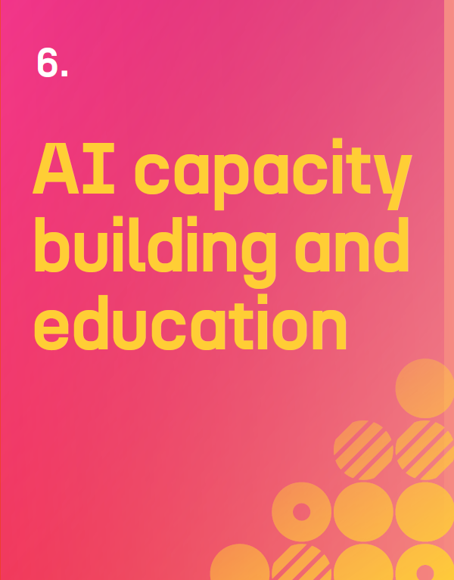
Capacity building and education
Establishing expert teams
Organising training programmes
Supporting knowledge exchange and cooperation
Documenting AI-related activities
Public education about the use and limits of AI in parliament

Slide 15
Translation and dissemination
Ensure global dissemination and outreach
Translations in multiple languages:
Initiated: German, Greek, Spanish
Planned: Arabic, French, Hebrew, Italian, Portuguese
Presentation and discussion in international fora
Collaboration with IPU and several IPIs

Slide 16
Further development and improvements
Draw from existing knowledge to refine and expand the guidelines
Update the guidelines with continuous input from experts in parliamentary affairs
Allow for adaptation to new challenges and advancements in AI technology
Organize international interactive workshops
Support individual parliaments to meet specific their needs
Synthesize human intelligence with advanced AI capabilities, such as LLMs
Apply design thinking principles to focus on user-centric aspects

Slide 17
To take part in this project
Email: antonino.nielfi@aph.gov.au
Disclaimer: The information and views set out in this presentation are only those of the author and do not necessarily reflect the official opinion of his institution.

