Slide 1
Parliament, resilience and the full power to make law
Dr Dean Knight, Professor of Law Te Herenga Waka—Victoria University of Wellington
dean.knight@vuw.ac.nz | @drdeanknight

Slide 2
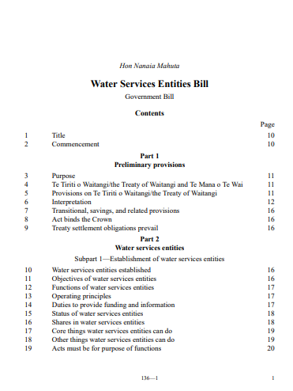
The Bill…
Water Services Entities Bill
cl 116 Obligation to maintain water services:
ie, entity must not divest, sell, dispose etc water services or significant infrastructure, without 75% majority in poll of local electors
22* Nov 2022

Slide 3
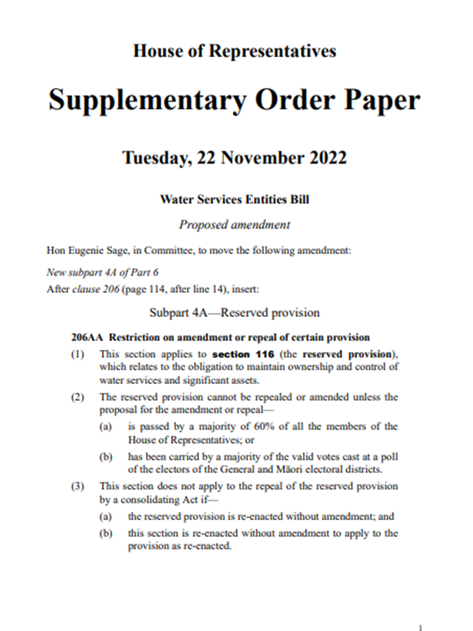
The inclusion…
Supplementary Order Paper 285
cl 206AA Restriction on amendment or repeal of certain provision
ie, cl 116 cannot be repealed or amended unless majority of 60% of MPs or majority at referendum
22* Nov 2022

Slide 4
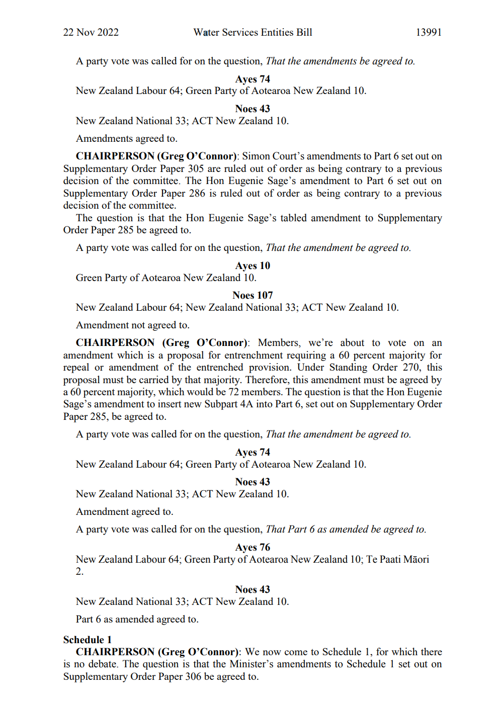
The inclusion…
“The question is that the amendment … in SOP 285 be agreed to”
“must be agreed by 60% majority” ie, 72 members
ayes 74 = Labour 64; Greens 10
noes 43 = National 33; ACT 10
amendment agreed to
22* Nov 2022

Slide 5
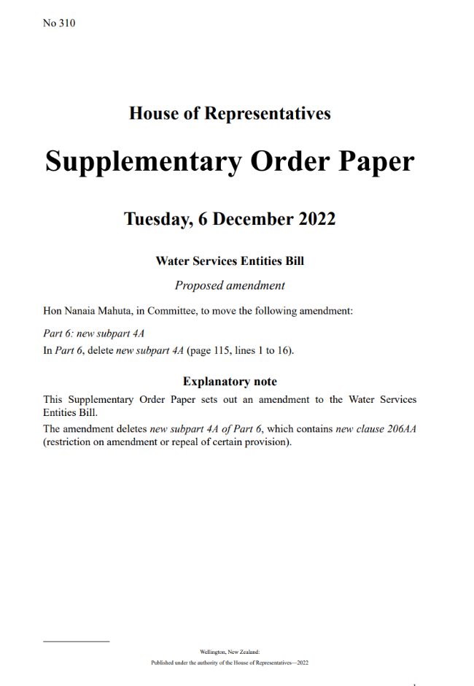
The removal…
Supplementary Order Paper 310
deletes new cl 206AA (restriction on amendment or repeal or certain provisions)
ayes 104; noes 10
amendment agree to
6 Dec 2022

Slide 6
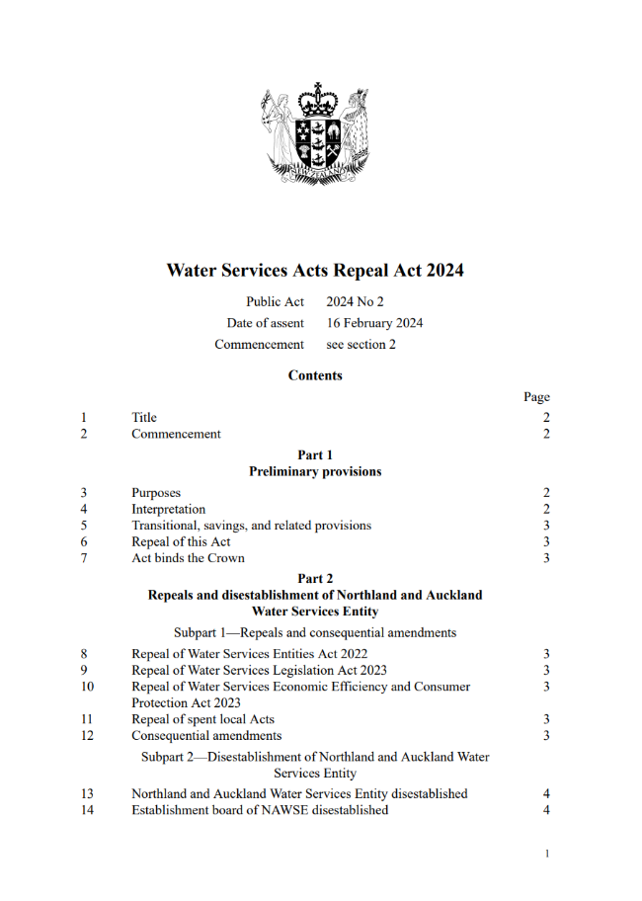
The burial…
Water Services Acts Repeal Act 2024
repeals Three Waters legislation, including Water Services Entities Act 2022
16 Feb 2024

Slide 7
The inclusion…
“The question is that the amendment … in SOP 285 be agreed to”
“must be agreed by 60% majority” ie, 72 members
ayes 74 = Labour 64; Greens 10
noes 43 = National 33; ACT 10
amendment agreed to
22* Nov 2022

Slide 8
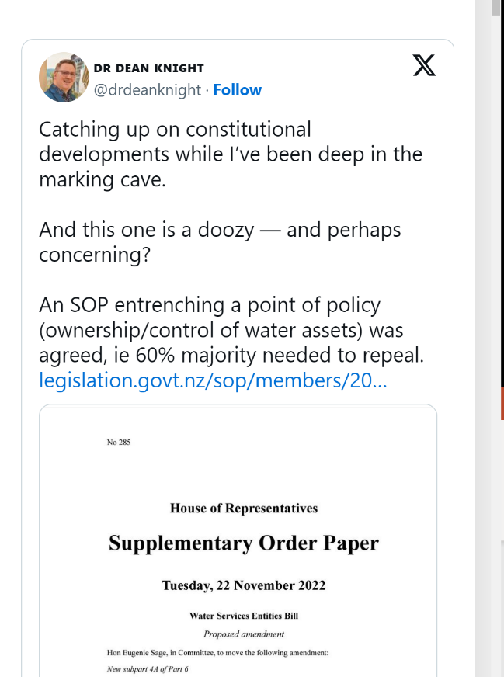
The concerns…
a doozy – perhaps concerning?
awkward
doesn’t sit well with our constitutional traditions
26 Nov 2022

Slide 9
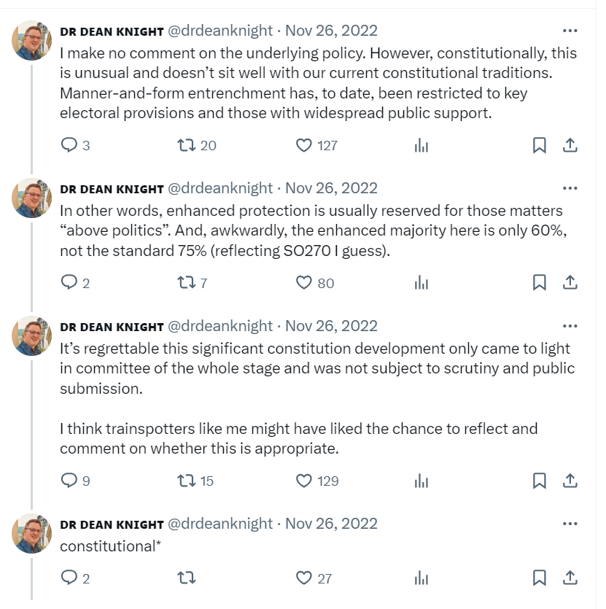
The concerns…
a doozy – perhaps concerning?
awkward
doesn’t sit well with our constitutional traditions
26 Nov 2022

Slide 10
The media…
‘Dangerous’: Last-minute Three Waters clause could change New Zealand's constitution
Three Waters: The misuse of power to entrench legislation
The chaos behind the Greens’ controversial Three Waters amendment
27 Nov 2022

Slide 11
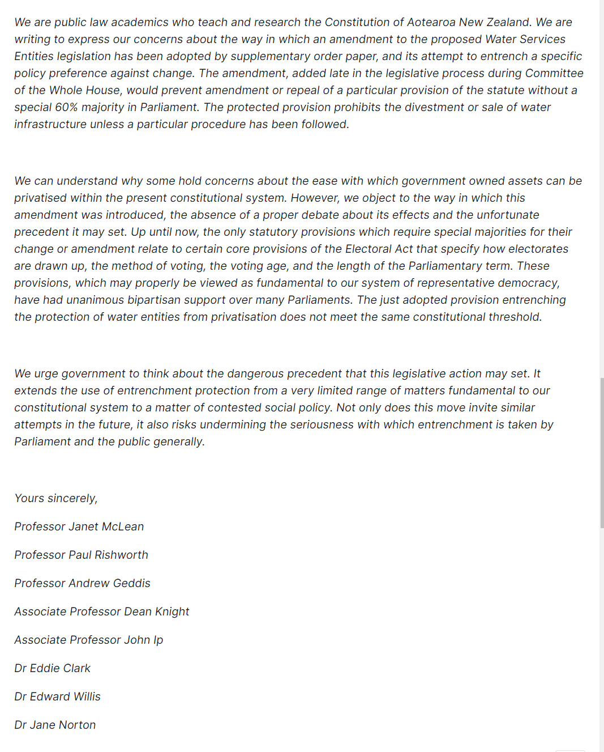
The concerns…
Open letter from 9 public law scholars
“dangerous precedent”
27 Nov 2022

Slide 12
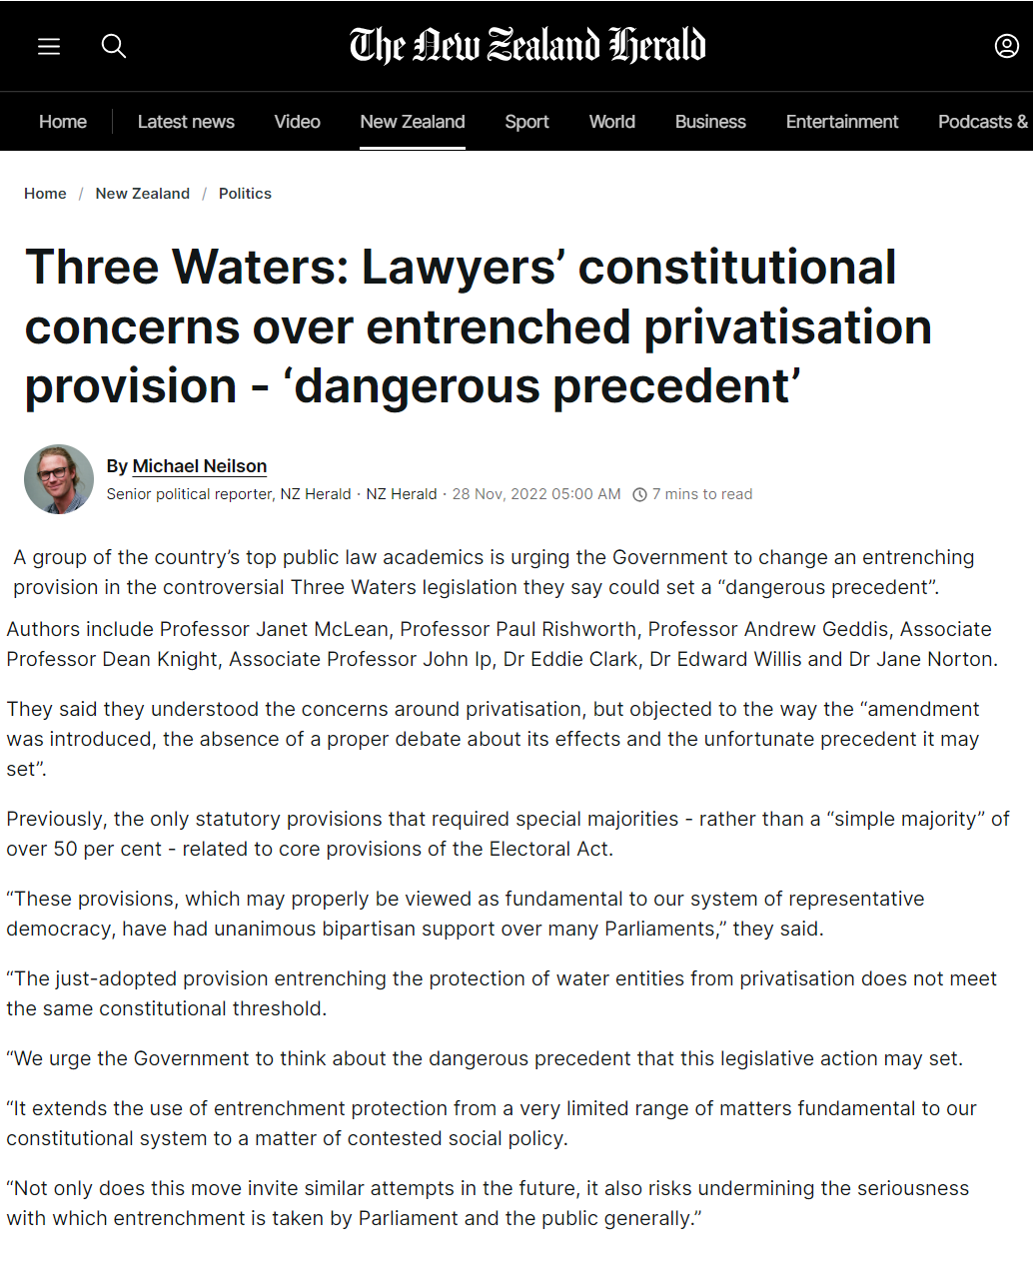
The concerns…
Open letter from 9 public law scholars
“dangerous precedent”
27 Nov 2022

Slide 13
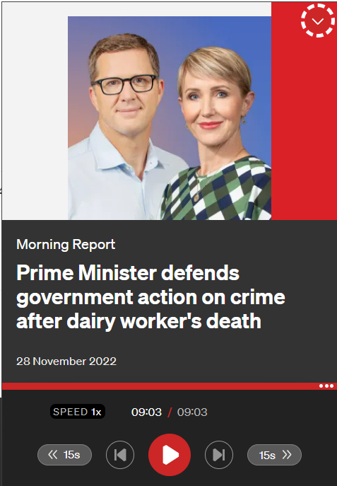
The pause for reconsideration…
clause was “a bit quirky”
“we agree it should be used rarely”
“Cabinet intends to have a bit of a discussion today about that principle”
28 Nov 2022

Slide 14
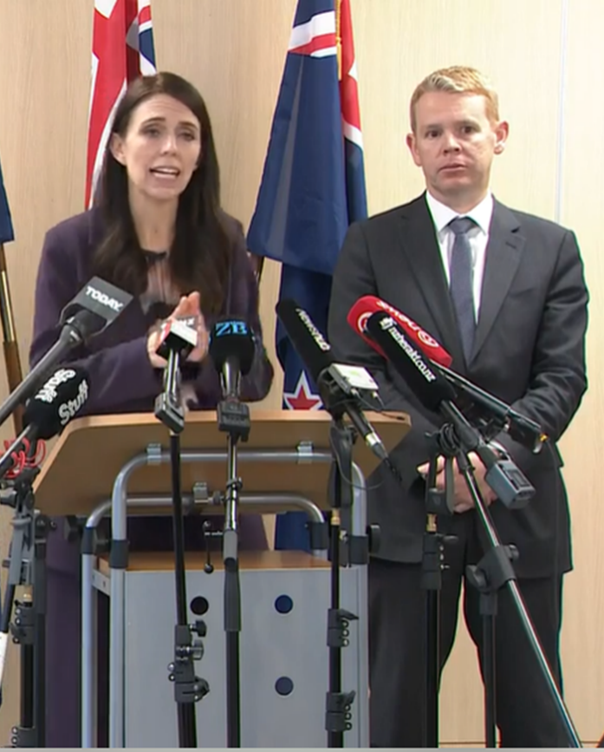
The pause for reconsideration…
understandable concerns about principle
“need to be cautious” in use of entrenchment
clause here was “novel”
need for wider discussion amongst parties via Business committee
28 Nov 2022

Slide 15
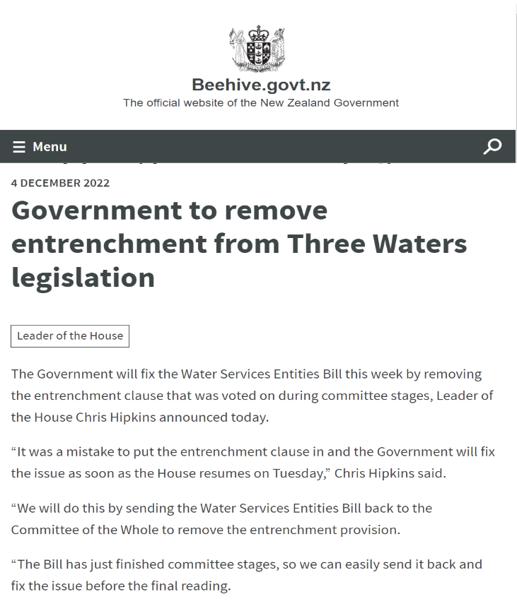
The removal…
inclusion was “a mistake”
“not typical” and “has wider ramifications”
question of entrenchment referred to Standing Orders committee
4 Dec 2022

Slide 16
The removal…
Supplementary Order Paper 310
deletes new cl 206AA (restriction on amendment or repeal or certain provisions)
ayes 104; noes 10
amendment agree to
6 Dec 2022

Slide 17
The removal…
Supplementary Order Paper 310
deletes new cl 206AA (restriction on amendment or repeal or certain provisions)
ayes 104; noes 10
amendment agree to
6 Dec 2022

Slide 18
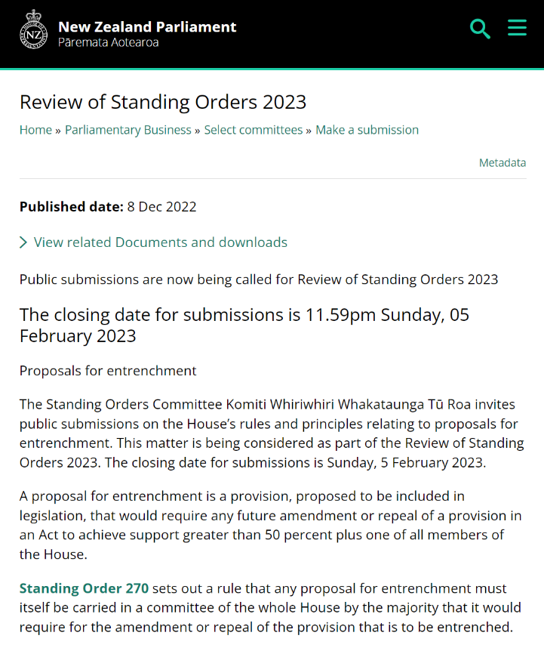
The review…
Review of Standing Orders 2023
how should the House approach proposals for entrenchment?
esp restrictions on subject matter, required majority and notice requirements
Dec 2022

Slide 19
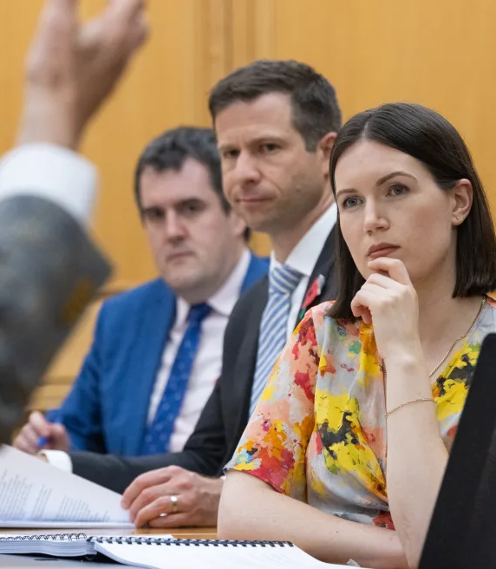
The review…
Review of Standing Orders 2023
how should the House approach proposals for entrenchment?
esp restrictions on subject matter, required majority and notice requirements
Feb 2023

Slide 20
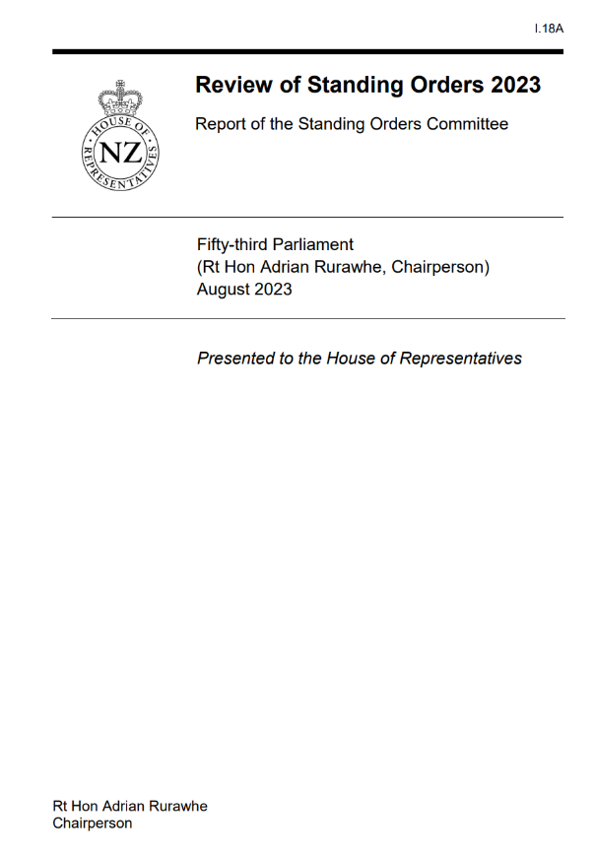
The review…
Review of Standing Orders 2023
proposed changes to procedure for consideration of proposals for entrenchment
30 Aug 2023

Slide 21
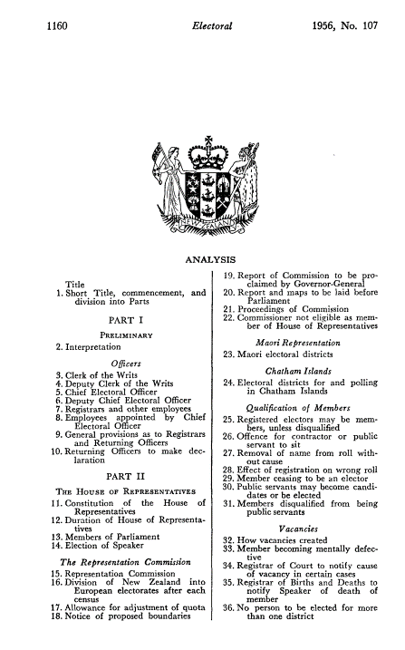
The pre-history…
Electoral Act 1956, s 189
6 “reserved” provisions, ie 75% majority of MPs or public referendum needed to amend or repeal
parliamentary term, Representation Commission, voting population, quota allowances, minimum voting age, method of voting
1956

Slide 22
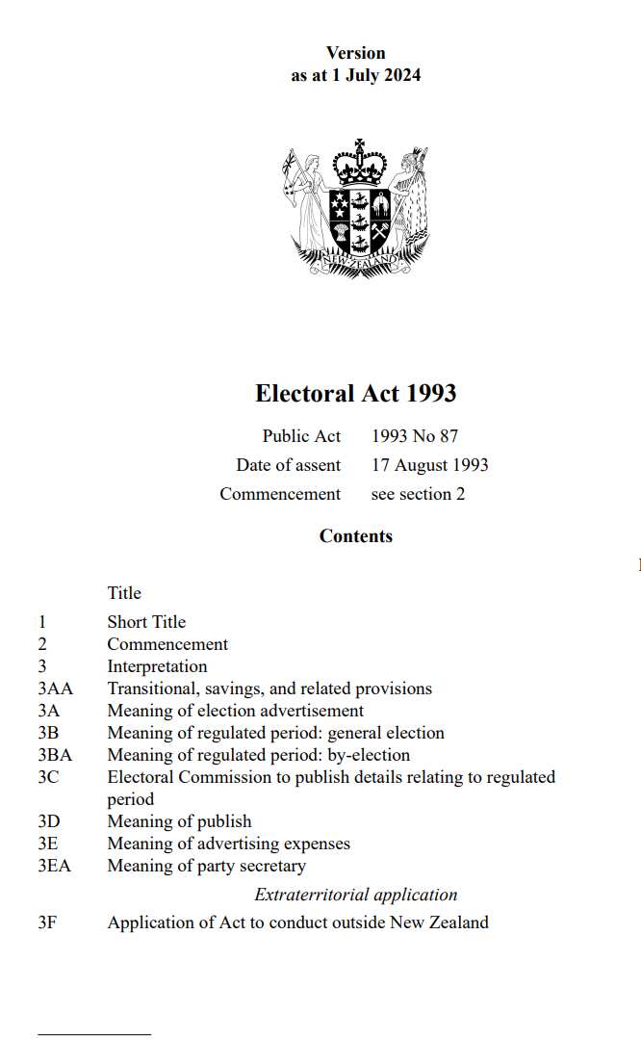
The current settings…
Electoral Act 1993, s 268
same key reserved provisions
1993-

Slide 23
The pre-history…
Electoral Act 1956, s 189
6 “reserved” provisions, ie 75% majority of MPs or public referendum needed to amend or repeal
parliamentary term, Representation Commission, voting population, quota allowances, minimum voting age, method of voting
1956

Slide 24
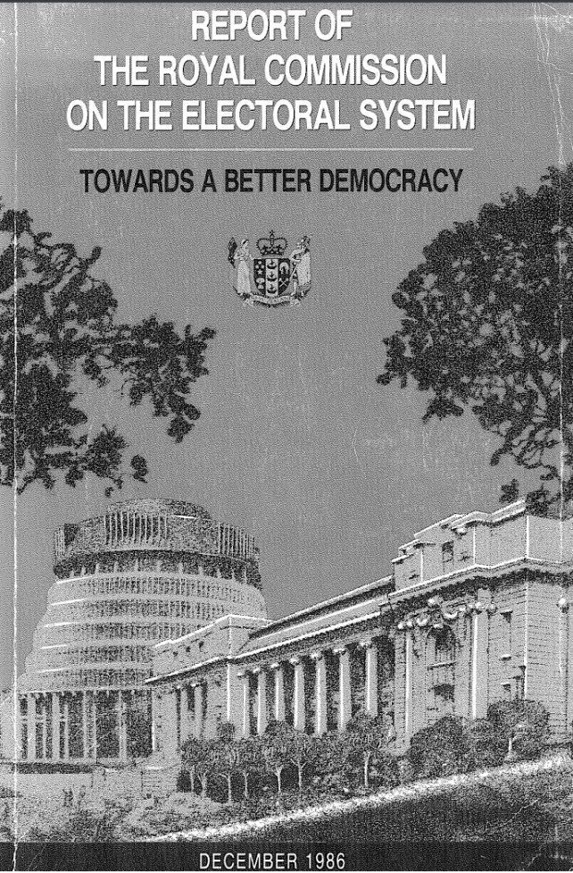
The pre-history…
Royal Commission on the Electoral System
moral or conventional rule successfully created
shift in mood about legal enforceability
Dec 1986

Slide 25
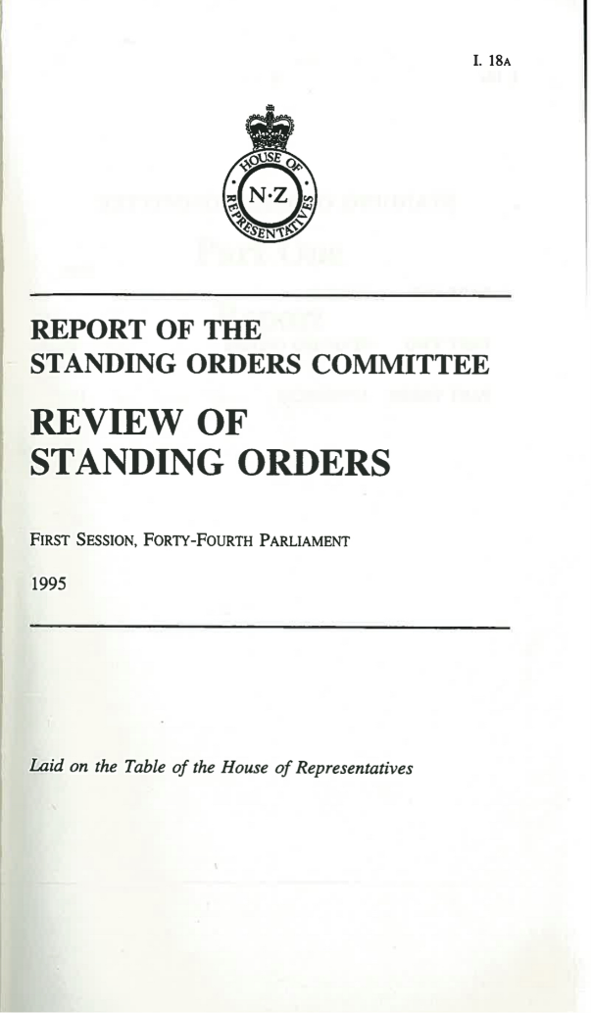
The pre-history…
Entrenched provisions
must be carried in committee of whole House by same majority it seeks to entrench
1995

Slide 26
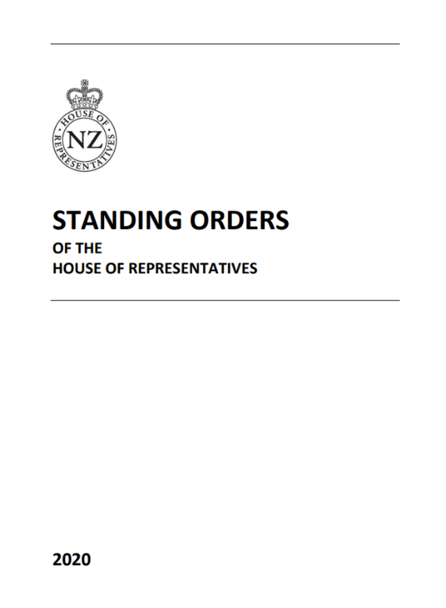
The current settings…
Entrenched provisions (SO 270)
must be carried in committee of whole House by same majority it seeks to entrench
2000-2023

Slide 27
The strengthening…
SO 270 Proposals for entrenchment
symmetry in enhanced majority
must be considered by select committee and be subject to public submission
cannot be passed through committee of whole under urgency
Sep 2023

Slide 28
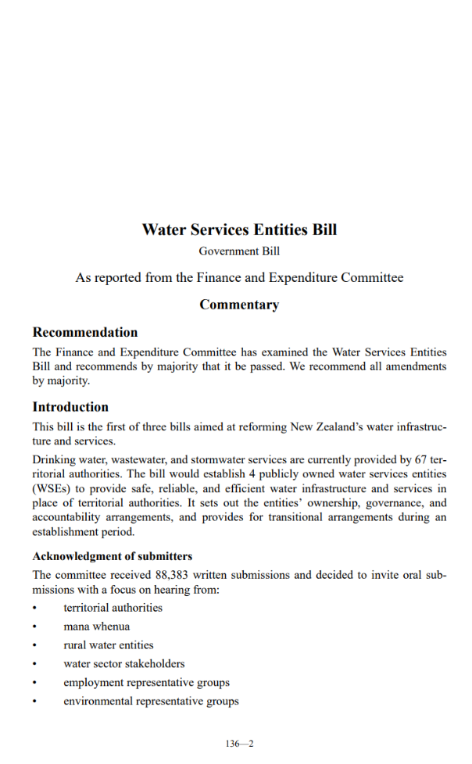
The Bill again…
Select Comm report: Greens differing view
disagreed with official advice that entrenchment inappropriate
considers 60% majority would be appropriate check against outsourcing
11 Nov 2023

Slide 29
The Bill again…
Supplementary Order Paper 285
cl 206AA Restriction on amendment or repeal of certain provision
ie, cl 116 cannot be repealed or amended unless majority of 60% of MPs or majority at referendum
22* Nov 2022

Slide 30
The vote…
“The question is that the amendment … in SOP 285 be agreed to”
“must be agreed by 60% majority” ie, 72 members
ayes 74 = Labour 64; Greens 10
noes 43 = National 33; ACT 10
amendment agreed to
22* Nov 2022

Slide 31
The concerns…
“dangerous precedent”
contested matter of policy/political weaponisation
upsets precedents about need for matter to be above politics
risks upsetting existing entrenchment equilibrium
hasty process didn’t allow due consideration
27 Nov 2022

Slide 32
The strengthening…
Review of Standing Orders 2023
symmetry in enhanced majority
must be considered by select committee and be subject to public submission
cannot be passed through committee of whole under urgency
30 Aug 2023

Slide 33
The strengthening…
SO 270 Proposals for entrenchment
symmetry in enhanced majority
must be considered by select committee and be subject to public submission
cannot be passed through committee of whole under urgency
Sep 2023

Slide 34
The reflections…
constitutional dynamics, culture and traditions
cause of the shenanigans
normative force of conventions
constitutional guardians
urgency addiction
rudimentary/narrow constitutional imagination
3 Oct 2024

Slide 35
Parliament, resilience and the full power to make law
Dr Dean Knight, Professor of Law Te Herenga Waka—Victoria University of Wellington
dean.knight@vuw.ac.nz | @drdeanknight

