Slide 1
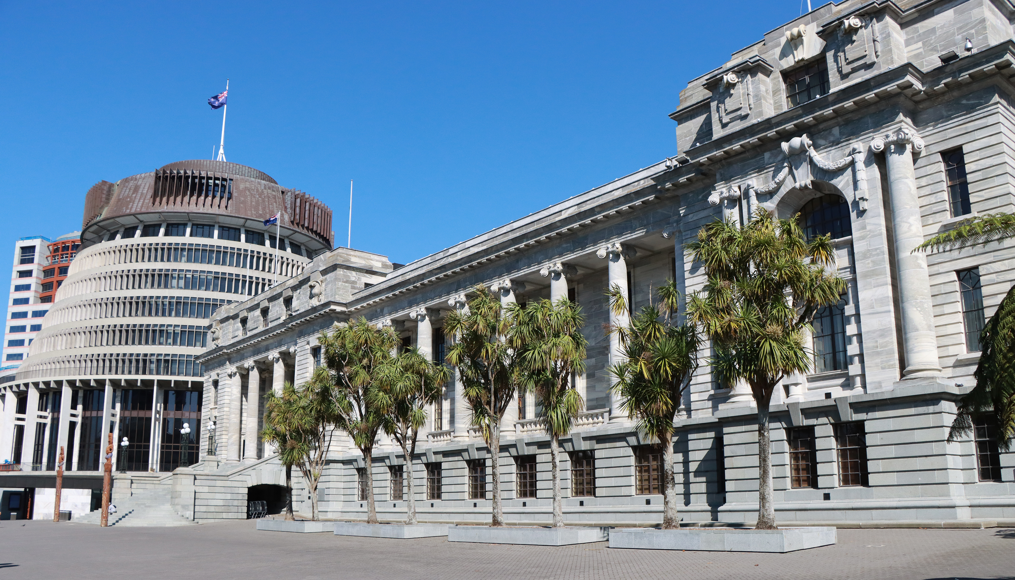
PANEL DISCUSSION
Parliamentary petitions and remote participation
Caleb Triscari, Parliament of Victoria
Hong Tran, Parliament of Victoria
Facilitator: James Picker,
Clerk Assistant (Committees)
New Zealand Chapter
Notes:
`

Slide 2
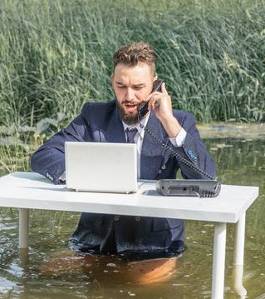
Beyond the Pandemic: To What Extent Should Parliament Embrace Remote Participation in the Digital Age?
Hong Tran
Dept. of Legislative Assembly, Parliament of Victoria

Slide 3
What I explored:
The emergence of remote participation during the pandemic in the UK, Australia (the Common
Key considerations underlying the implementation of remote participation in these jurisdictions
Testing these consideration in future circumstances

Slide 4
The emergence of remote participation during the pandemic
The UK Parliament
House of Commons
House of Lords
The Australian Parliament
House of Representatives
Senate
The Parliament of Victoria
Legislative Assembly
Legislative Council
The New Zealand Parliament

Slide 5
The UK House of Commons
Early rising for the Easter break with a plan for remote participation when return
On 21 April 2020: hybrid system, caps of 50 members in the Chamber and 120 members remotely
Initially for scrutiny only, soon expanded to debates and legislation; remote voting agreed on 22 April
2 June: return to physical, but allowed remote scrutiny proceedings to members unable to attend physically
Return to fully physical on 18 August 2021

Slide 6
The UK House of Lords
21 April 2020: sat physically to move and agree on virtual sittings, then moved on to virtual sitting on Question Time.
Alternated between virtual and physical sittings
Virtual sittings allowed for questions, statements, debates on statutory instruments with decisions made in the Chamber
Committee stage of bills allowed on 6 May 2020
Moved to hybrid sittings on 8 June 2020, having the same status as normal sittings, remote voting for divisions
Members attended remotely could vote and be counted for quorum
On 12 July 2021: return to physical sittings but allowed remote participation for members unable to attend due to long-term disability; only for statements and questions

Slide 7
Australian Parliament
Initially tried to use other solutions: pairing, physical distancing in the Chamber, temporary shutdown, establishing a special committee to scrutinise the Government
First allowed on 24 August, then continued on a fortnightly sitting basis throughout 2020 though restrictions in Canberra were significantly loosened during 9-12 November sittings and many parliamentarians returned to the Chamber.
Attending remotely required Presiding Offers’ approval, subject to their satisfactions that members were unable to attend physically due to COVID-related reasons; had to use official video link and be at the EO/CPO
Could contribute to debates; ask/answer questions
Could not vote or counted for quorum

Slide 8
Victorian Parliament
Favoured other solutions
The LA: started to consider from 23 Apr 2020 and allowed on 3 Sep 2020; continued on a weekly sitting basis; allowed for some sitting weeks in 2021 and ceased on 26 Oct 2021;
The LC started to consider on 18 Aug 2020 but adjourned indefinitly. On 7 Sep 2021: the House required the President to have report on the possible application. After the President’s report, remote participation was allowed on 15 Sep 2021, expired on 31 Dec 2021.
Allowed actions: contribute to debates, ask questions, raise ADJ matters, personal exp.
Not allowed to vote or counted for quorum

Slide 9
New Zealand Parliament
Did not apply remote participation for most of the pandemic; other solutions: one month shutdown, aligning with national lockdown 25 Mar-28Apr and reduced attendance
Adopted remote participation on 17 Feb 2022 as a response to Omicron’s high transmission rate;
No limits on members’ actions. Only quorum in the Chamber required.
Use proxy voting
Allowed from 1 Mar to 31 Aug 2022.
Now made a core part of the proceedings.

Slide 10
The principles underlying remote participation
Functionality
Constitutionality
Procedure and formality
Practicality

Slide 11
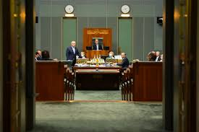
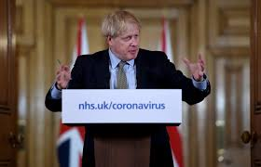
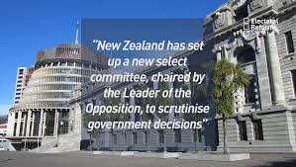
Functionality
Functionality highlights the purpose of keeping Parliaments functioning as key driver
In speech:
a bit to keep democracy going during the coronavirus crisis
a necessary solution to maintaining business continuity while a significant number of members are unable to attend […] in person
potentially, senior members of Parliament [were] unable to attend and participate in parliamentary proceedings unless we find an alternative way for them to do so
In practice: closely followed the COVID condition in each jurisdiction
The adoption was just on a necessary basis, stopped when the necessity expired.

Slide 12
Constitutionality
High concern to ensure compliance with the constitutional requirements
All jurisdictions sought to navigate the constitutional provisions
All hybrid to ensure the House still met in the Chamber
UK, Australia and Victoria: limited scope of remote participation
New Zealand: must maintain quorum in the Chamber

Slide 13
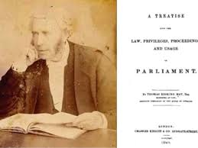
Procedure and formality
Focus on adhering to parliamentary practices
Guidance ensuring virtual proceedings reflected the procedure in the House as much as possible
Additional rules applied to remote participation to safeguard the procedures and formality of proceedings:
No displaying or drawing attention to objects
must participate with the same formality as though they were in the Chamber, and wear normal business attire

Slide 14
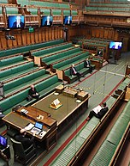
Practicality
Constrained by the availability and accommodability of technology and costs
Limitations:
No interjection
Lost in-person interaction
Lost spontaneity
Disruptions
Technical and human costs

Slide 15
Testing the principles of remote participation against future circumstances
Functionality
Constitutionality
Procedure and formality
Practicality

