Slide 1
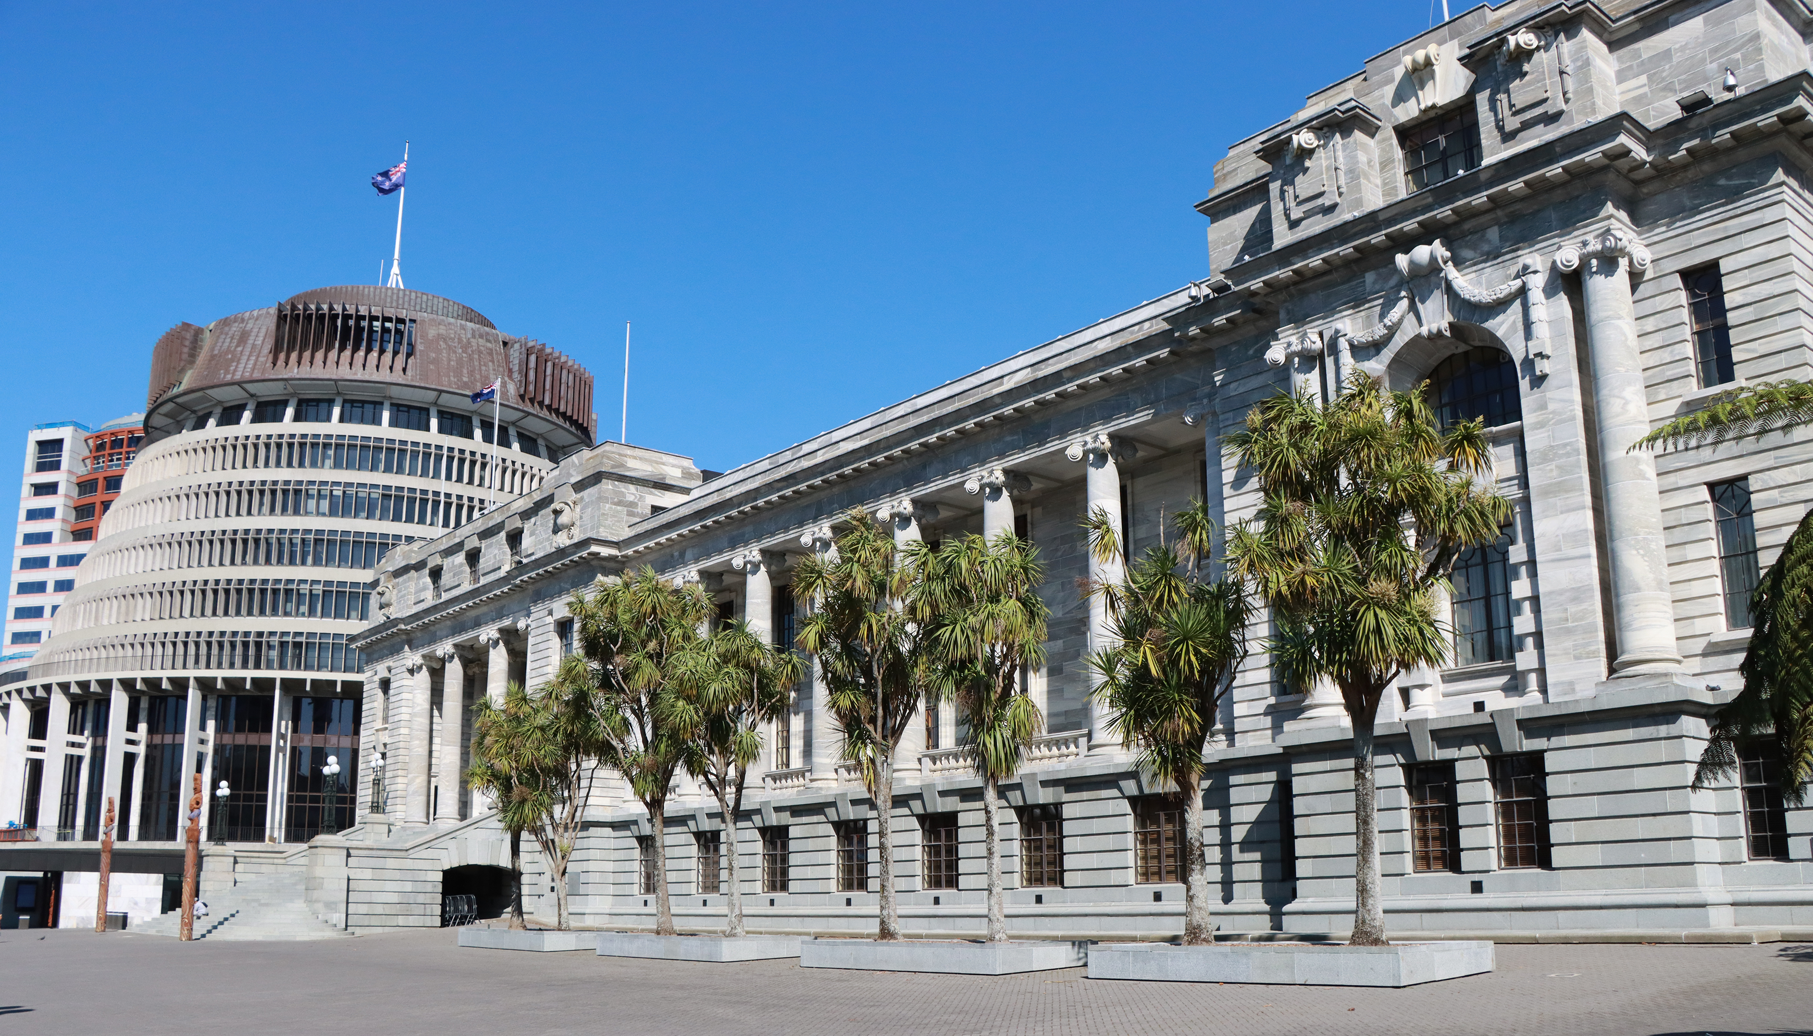
ASPG ANNUAL CONFERENCE 2024
Pauline Cullen
Parliament of Australia
Raising the Standard – an inquiry by the Procedure Committee
New Zealand Chapter
Notes:
`

Slide 2
Inquiry into recommendations 10 and 27 of Set the standard: Report on the Independent Review into Commonwealth Parliamentary Workplaces Standing Committee of Procedure
Pauline Cullen -Director Chamber Research

Slide 3
Outline
Background to the Jenkins Review
The Procedure Committee
The Inquiry
Recommendations
Government response

Slide 4
The lead up
The review was conducted for a variety of reasons, including gradual movements which called for change including the #MeToo movement and the Respect@Work: Sexual Harassment National Inquiry Report, commissioned in 2018 and released in 2020.
There were also a series of highly publicised news stories including “Inside the Canberra Bubble” and also a well-publicised incident within Parliament House.
Two other reviews took place.
Notes:
On 16 February 2021, the Prime Minister Scott Morrison, tasked a review of the procedures and processes involved in identifying, reporting and responding to serious incidents that occur during parliamentary employment. This was triggered by deeply distressing reports of an alleged sexual assault in a Ministerial office in March 2019 made public the previous day.
The review was undertaken by the Stephanie Foster PSM, Deputy Secretary of the Department of Prime Minister and Cabinet and was due in one month.
On 17 February 2021, the Prime Minister announced the Secretary of PMC would conduct a review to ‘check whether staff in his political office had any knowledge of the allegation before it became public in February this year.’
This review was suspended several times.

Slide 5
Independent Review
The aim of the review was ‘…to ensure all Commonwealth Parliamentary Workplaces are safe and respectful and that our national Parliament reflects best practice in the prevention and handling of bullying, sexual harassment and sexual assault’.
The Review considered recommendations to ensure that the people who work in parliamentary workplaces are treated with dignity and respect and have access to clear and effective mechanisms to prevent and address bullying, sexual harassment and sexual assault.
Notes:
The Government, in consultation with the Presiding Officers, the Opposition, minor parties and independent Members of Parliament established an Independent Review (Review) into the workplaces of Parliamentarians and their staff (parliamentary workplaces) on 5 March 2021.

Slide 6
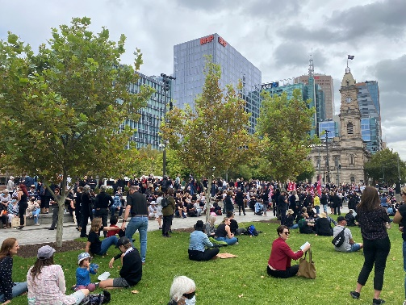
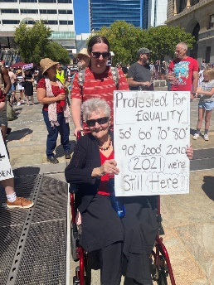
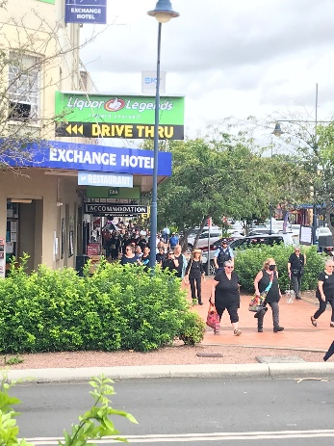
March 4 Justice – 15 Mar 2021
Notes:
Around Australia and in front of Parliament House

Slide 7
The conduct of the review
The Independent Review into Commonwealth Parliamentary Workplaces was conducted by Australia’s Sex Discrimination Commissioner, Kate Jenkins in accordance with section 11 of the Australian Human Rights Commission Act 1986 in 2021.
1723 individuals and 33 organisations and collectives contributed
302 written submissions, 935 survey responses, 490 interviews and 11 focus groups
37 per cent of people currently working in Parliament had experienced some form of bullying and 33 per cent had experienced sexual harassment.
The report made 28 recommendations.

Slide 8
Procedure Committee
The Procedure Committee is established by Standing Order 221 to inquire into and report on the practices and procedures of the House and its committees.
The Committee consists of 7 Members of the House (4 government and 3 non-government) and can determine its own inquiries within the broad framework of its overall terms of reference.
The Committee operates under the standing orders applying to committees generally (standing orders 228-247).
Each parliament it undertakes an inquiry into the maintenance of the standing orders, and other inquiries as it chooses.

Slide 9
Set the Standard Recommendation 10
The Set the Standard report made 28 recommendations and the Procedure Committee chose to inquire into two of these recommendations:
Recommendation 10: Everyday respect in the parliamentary chambers
The Presiding Officers should review the Standing Orders and unwritten parliamentary conventions, including their application in practice, with a view to:
eliminating language, behaviour and practices that are sexist or otherwise exclusionary and discriminatory
improving safety and respect in the parliamentary chambers.

Slide 10
Set the Standard Recommendation 27
Recommendation 27: Review of Parliamentary sitting calendar and Order/Routine of Business
The Procedure Committees of the House of Representatives and the Senate should review the Parliamentary sitting calendar and the Order/Routine of Business with a view to enhancing wellbeing, balance and flexibility for parliamentarians and workers in Commonwealth parliamentary workplaces.

Slide 11
Inquiry terms of reference
To inquire into and report on:
practices and procedures of the House with a view to:
eliminating language, behaviour and practices in the parliamentary chambers that are sexist or otherwise exclusionary and discriminatory, and
improving safety and respect in parliamentary chambers, and
the Parliamentary sitting calendar and the House and Federation Chamber Orders of Business, with a view to enhancing wellbeing, balance and flexibility for Members and workers in Commonwealth parliamentary workplaces.

Slide 12
Conduct of the inquiry
The committee made a targeted call for submissions and noted that it would not be looking at codes of conduct or behaviour outside the Chamber.
The Committee received 8 submissions and held 4 public hearings.
It met with former Speakers, academics and also with Ms Kate Jenkins.
It also held private briefings with parliamentary officials and office holders.

Slide 13
Everyday respect in the Chamber
The standing orders relating to disorder (standing orders 88 to 96) detail the behaviours that are considered disorderly and the actions available to the Speaker or occupant of the Chair to enforce order in the House.
The committee also maintained the importance of robust debate and that the Chamber is a forum for the frank exchange of ideas.
Evidence asked whether there needed to be explicit changes to the standing orders.
Notes:
The committee was cautioned against making a list of offensive terms, with former Speaker Jenkins noting that it would easily date.
Exactly what constitutes ‘offensive’, ‘objectionable’ and ‘unparliamentary’ language is not defined in the standing orders and is a matter for the Speaker to determine. In her submission, the Clerk of the House, Ms Claressa Surtees, noted:
It is the Speaker, or indeed the Member acting as Chair at the time objection is raised, who determines whether words used are offensive or disorderly. The Speaker’s judgement depends on the nature of the words, as well as their context. The Speaker may be guided by relevant precedents and rulings by former Speakers, such as those cited in House of Representatives Practice.[7]
Standing order 92 empowers the Speaker to intervene when a Member’s conduct is considered offensive or disorderly. This standing order also allows the Speaker to determine if a Member’s conduct is offensive or disorderly when it is brought to their attention by another Member. Earlier this year, the Speaker reminded Members of this process:
… I want to reiterate to all members: if you believe you have been spoken about in a way that is disrespectful or indeed if any member believes another member has been spoken about in a way that is disrespectful, the time to raise that issue is when it happens. At the discretion of the chair, action may be taken at the time when a comment is brought to the attention of the chair.[5]
The committee also considered that the current standing orders did provide the Speaker or occupant of the Chair with sufficient authority to continue to rule on offensive language ‘based on the context in which it is used and community and parliamentary standards.’
The committee acknowledged the evidence received that changing the standing orders would strengthen the Speaker’s ability to rule such language out of order, set expectations about the tone of parliamentary debate and demonstrate to the community that these words are not acceptable in any environment.

Slide 14
Recommendation 1
89 Offensive words
A Member must not use offensive words, including words that are sexist, racist, homophobic and otherwise exclusionary or discriminatory, against:
(a) either House of the Parliament or a Member of the Parliament; or
(b) a member of the Judiciary.

Slide 15
Use of sanctions
Standing orders 94 to 96 outline existing sanctions which include that a member can be directed to leave the chamber for one hour under standing order 94(a).
The direction is not open for debate or dissent and House of Representatives Practice notes that if a Member does not leave the chamber immediately or continues to act in a disorderly manner, they may be named.
Naming of a member is provided for under standing order 94(b). When a Member is named by the Speaker, a motion for the Member to be suspended from the service of the House may be moved and must be resolved without amendment, adjournment or debate.
Notes:
The Procedure Committee had previously considered increased sanctions when it inquired into practices and procedures relating to Question Time.
They had recommended amending standing order 94(a) to add three hours as an additional sanction.The recommendation was not accepted by the Government of the time.
Evidence to the committee suggested that the current sanctions were not sufficient and not enough of a deterrent.
The current Speaker and former Speakers were supportive of additional options to sanction Members.

Slide 16
Recommendation 2
94 Sanctions against disorderly conduct
(a) The Speaker can direct a disorderly Member to leave the Chamber for:
(i) one hour; or
(ii) three hours, where there is continued or escalating disorderly conduct.
The direction shall not be open to debate or dissent, and if the Member does not leave the Chamber immediately, the Speaker can name the Member under the following procedure.

Slide 17
Awareness, guidance materials and training
The committee also considered awareness, guidance materials and training, receiving evidence that training can change awareness and recognition of behaviours as they happen.
They stated that they expected that Member were aware of ‘their obligations to behave respectfully and not to use offensive language against other Members or objectionable words in the Chamber.’

Slide 18
Recommendation 3
The Committee recommends that the Department of the House of Representatives review the guidance material and training available to Members to ensure Members are aware:
words that are sexist, racist, homophobic and otherwise exclusionary or discriminatory are considered offensive words under standing order 89,
disorderly conduct under standing order 91 includes acts of bullying and sexual harassment in the Chamber, and
under standing order 92(b), a Member may draw the Speaker’s attention to the conduct of a Member.

Slide 19
Recommendation 4
The Committee recommends that the Speaker and the Department of the House of Representatives ensure guidance for members of the Speaker’s Panel, and for chairs and deputy chairs of parliamentary committees, is updated to reflect any changes to standing orders made from recommendations in this report.

Slide 20
Changes to sitting hours
The committee heard evidence of the changes to the Order of Business which took place at the start of the 47th Parliament.
These were amendments to standing orders 50 and 133, providing for deferred divisions after 6.30pm on Monday, Tuesday or Wednesday.
There were also changes to standing orders 82 and 85 relating to urgent bills.
The impact on Members’ staff and parliamentary staff was considered.
Notes:
The committee decided to continue to monitor changes during the remainder of the Parliament and to make any comments in their report on the maintenance of the standing orders.

Slide 21
Other potential changes
The committee looked more broadly at ways that there could be changes to the unwritten parliamentary conventions, matters such as representation and other changes that may improve safety and respect.
They received evidence which proposed increasing opportunities for discussion gender equality, diversity and inclusion and the creation of a parliamentary group or committee on gender equality, diversity and inclusion.

Slide 22
Recommendation 5
The Committee recommends that House consider establishing a House Standing Committee on Gender Equality, Diversity and Inclusion to:
scrutinise the work of the Australian Public Service from a gender, diversity and inclusion perspective
scrutinise the potential effects of proposed legislation on gender equality, diversity and inclusion, and
inquire into and report on matters related to gender, diversity and inclusion.

Slide 23
Recommendation 6
The Committee recommends that, during the next major review of the standing orders, the House consider removing masculine and feminine pronouns from the standing orders, and replacing them with gender-neutral alternatives.

Slide 24
Government & Speaker response
On 16 May 2024, the Government presented a response to the report.
They noted three recommendations and agreed to recommendation 2.
The remaining recommendations were responded to by the Speaker.

Slide 25
Notice of motion

