Slide 1
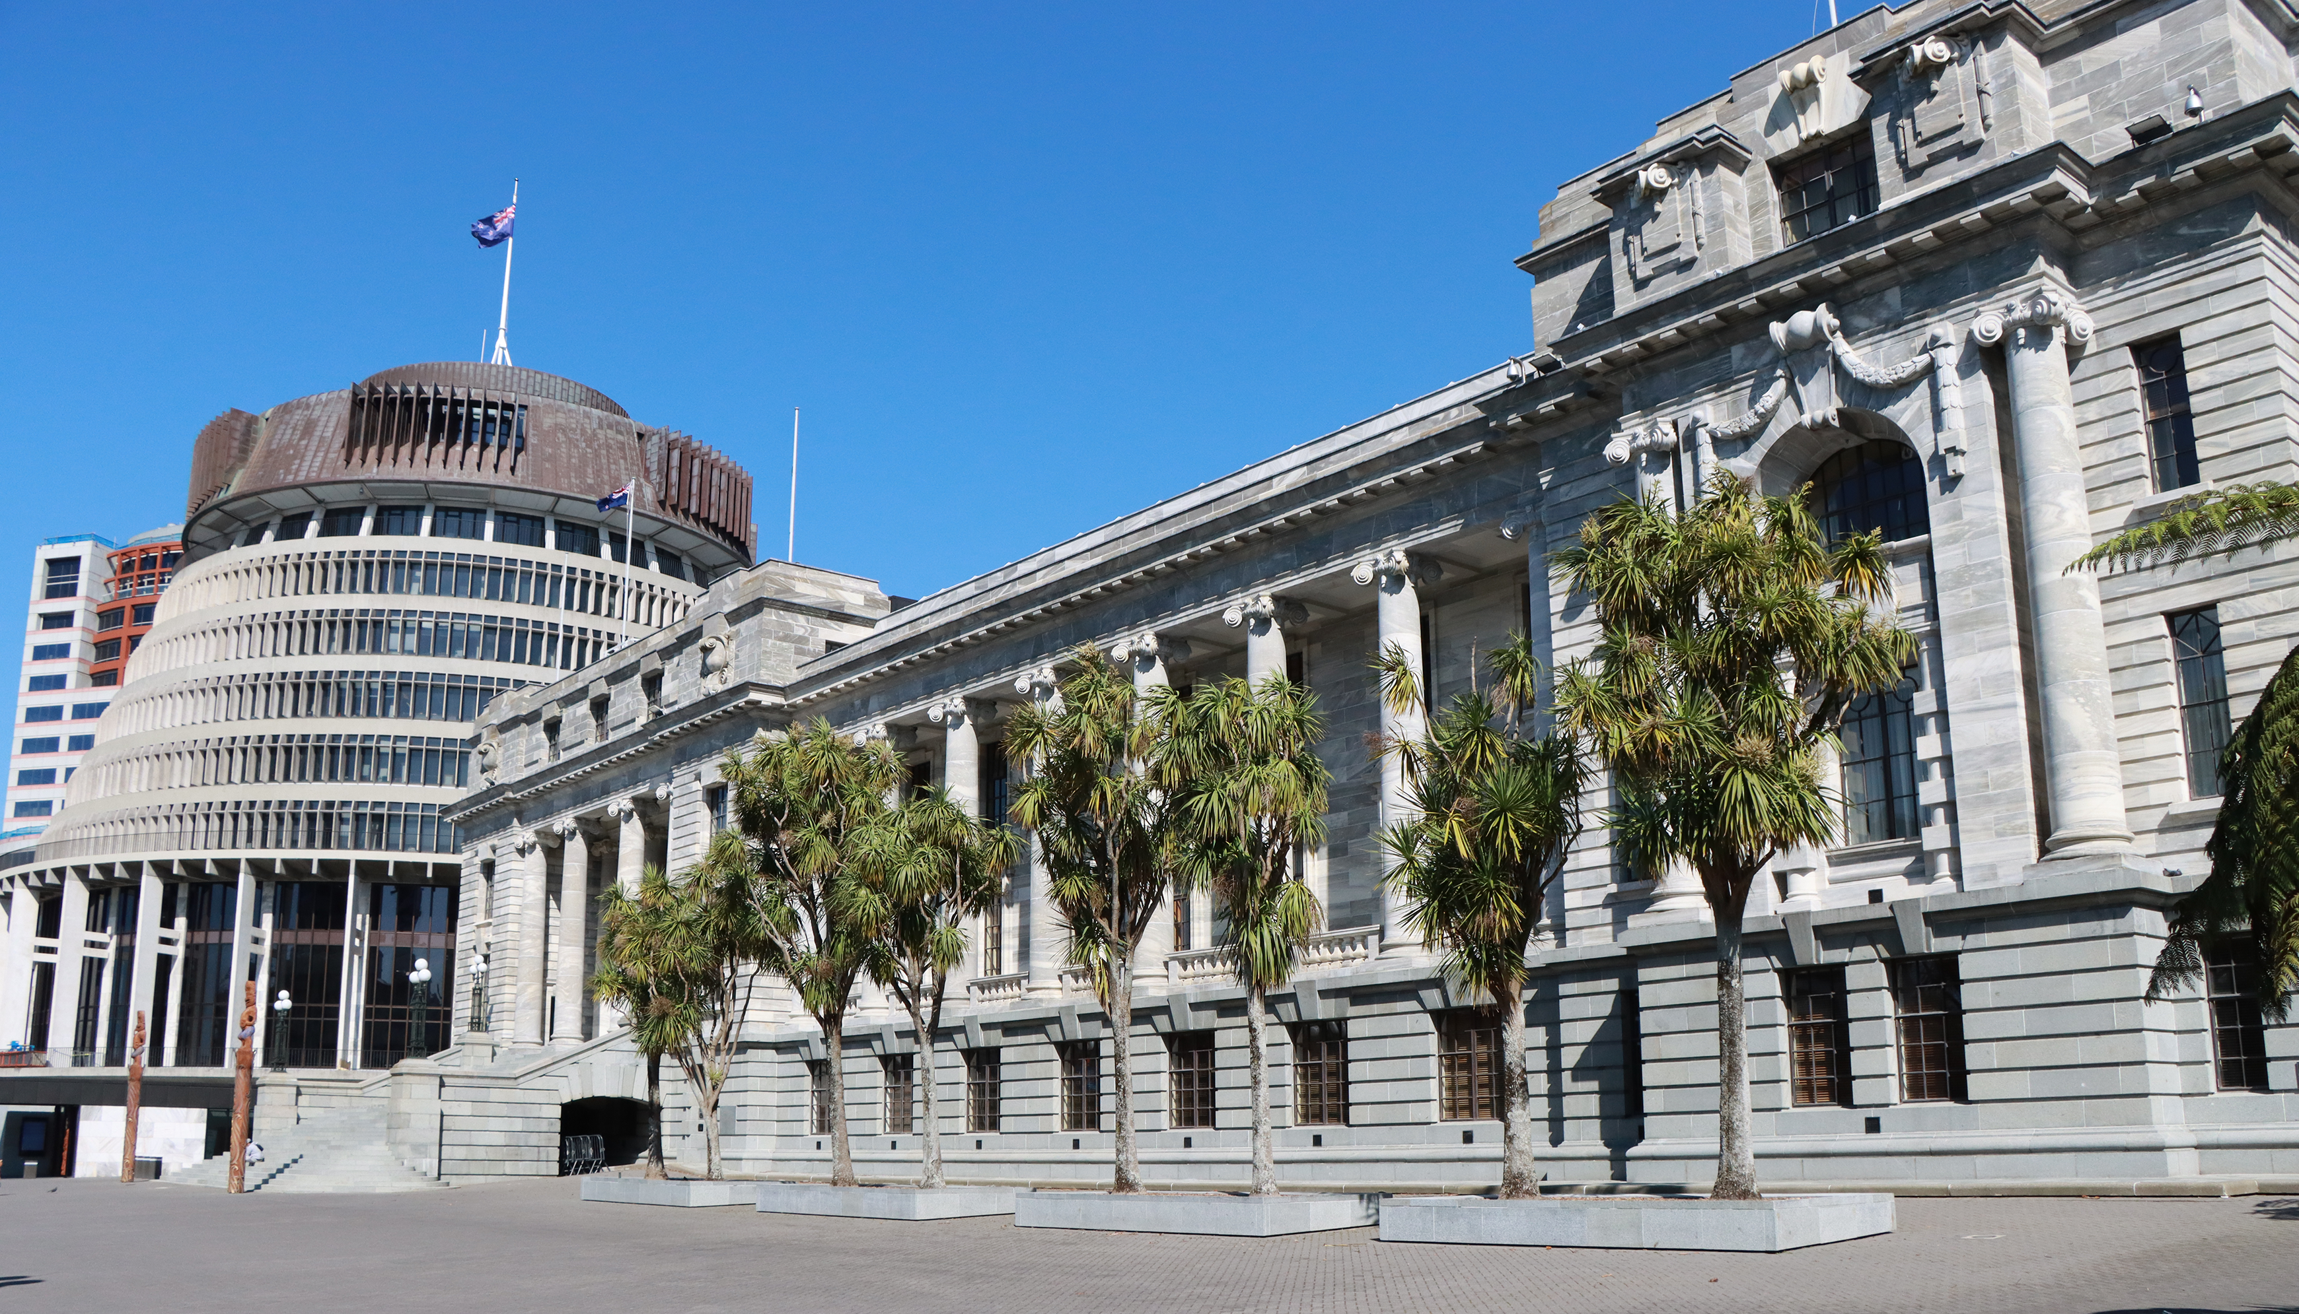
ASPG ANNUAL CONFERENCE 2024
Maria Mead
Parliament of Queensland
Turbocharging civics education for parliamentary resilience: A case study of Queensland Parliament’s 2024 ‘Build your Parliament in Minecraft’ competition for schools.
New Zealand Chapter
Notes:
`

Slide 2
Australasian Study of Parliament Group Conference | Wellington NZ | 2 – 4 October 2024
Build Your Parliament in Minecraft
Schools’ Competition
Maria Mead
Parliamentary Education Officer
Notes:
PAPER Title: Turbocharging Civics Education for Parliamentary Resilience Subtitle: A Case Study of the 2024 ‘Build Your Parliament in Minecraft’ Competition
Copies available
Brief welcome and introduction.

Slide 3
Notes:
Acknowledgement of country
RAP artwork by Casey Coolwell, Quandamooka

Slide 4
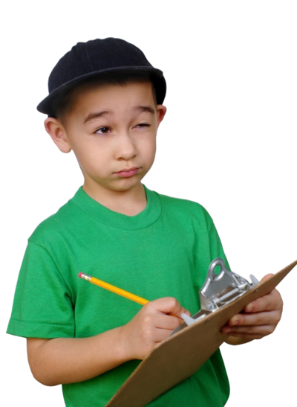
Turbocharging CIVICS education
My first lesson in democracy?
Objective: To activate our prior experience with civics education
Notes:
Think back to when you were in school.
…What was your first experience learning about how democracy works?
Share with the person next to you how it shaped (or misdirected) your understanding of governance.

Slide 5
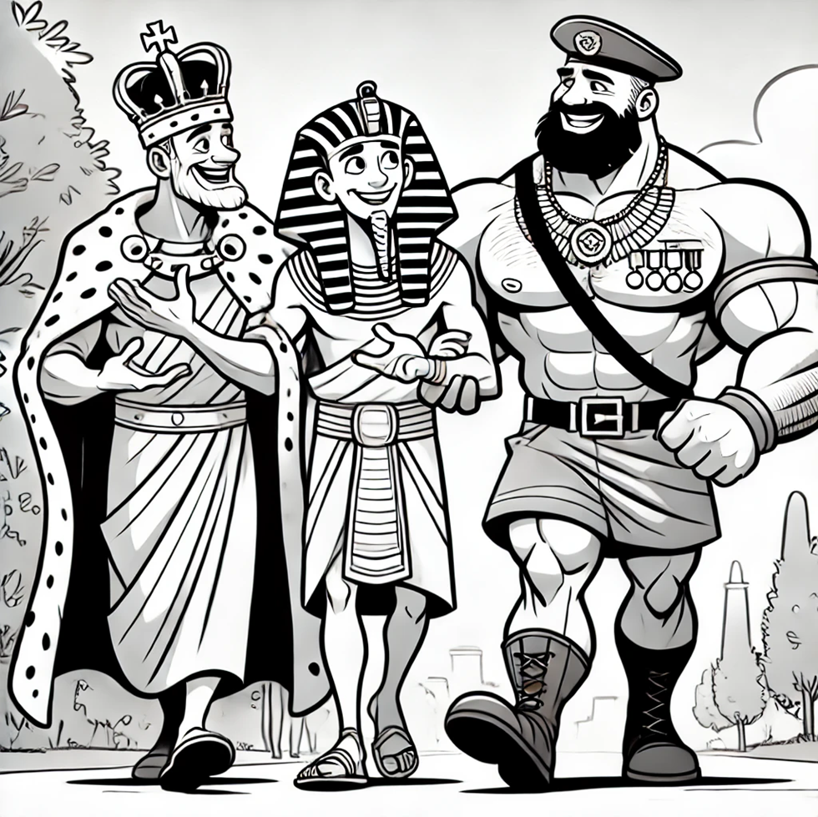
Turbocharging CIVICS education
Right. As long as democracy depends on a well-informed public, we’re OK.
Drawing generated by OpenAI, 2024.
Adapted from a cartoon by Charles Barsotti, NYT cartoonist
Objective: To reflect on civics education as a strategy to safeguard democracy.

Slide 6
Turbocharging CIVICS education
Educational approaches
Gamification
Digital platforms, virtual worlds
Experiential learning
Learning objective: To examine proven educational strategies to enhance and modernise civics education

Slide 7
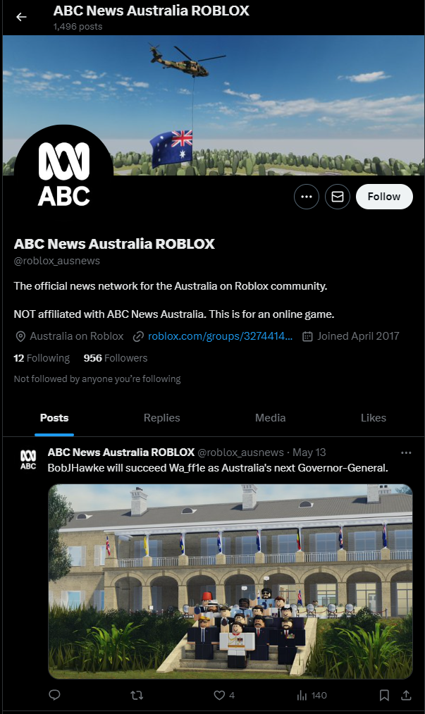
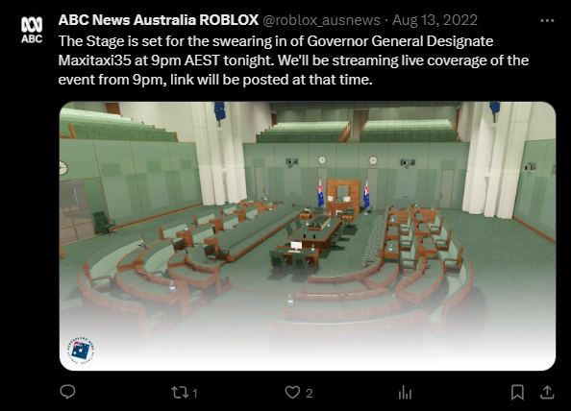
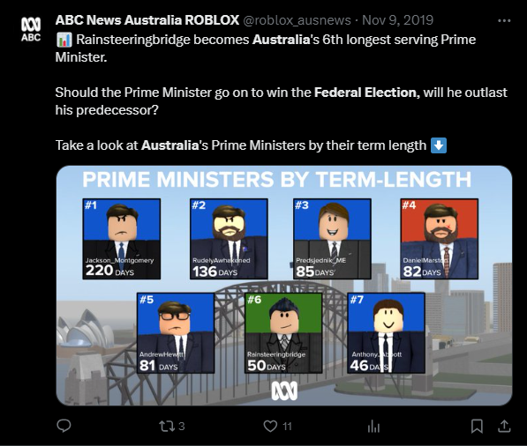
Turbocharging CIVICS education
Learning objective: To consider one example of civic engagement in a virtual space

Slide 8
Turbocharging CIVICS education
Pilot project
Competition
Engagement
Virtual resource
Learning objective: To review how the competition project idea took shape

Slide 9
JUL 23: Consultation with IT and Communications Teams
5 JUN 24: Entries due
Building
OCT 23: Speaker’s submission approved
Project Timeline
15 APR 24: Resource Packs released
Judging
OCT 23: Promotion to key education contacts via email
18 JUN 24: Winners announced
MAR-APR 24: Team registration
5 AUG 24: Prize presentation
NOV 23: Expressions of Interest invited
SEP 24: Design of graphic assets
JUL 24: Minecraft teaching resource published online
Learning objective: To consider the contributing elements and the necessary timeframe for a successful competition project

Slide 10
Turbocharging CIVICS education
Participation in the Competition
Register and form a team
Resource Pack items
Build replica Chamber
Document team progress
Learning objective: To outline the process for participation in the competition

Slide 11
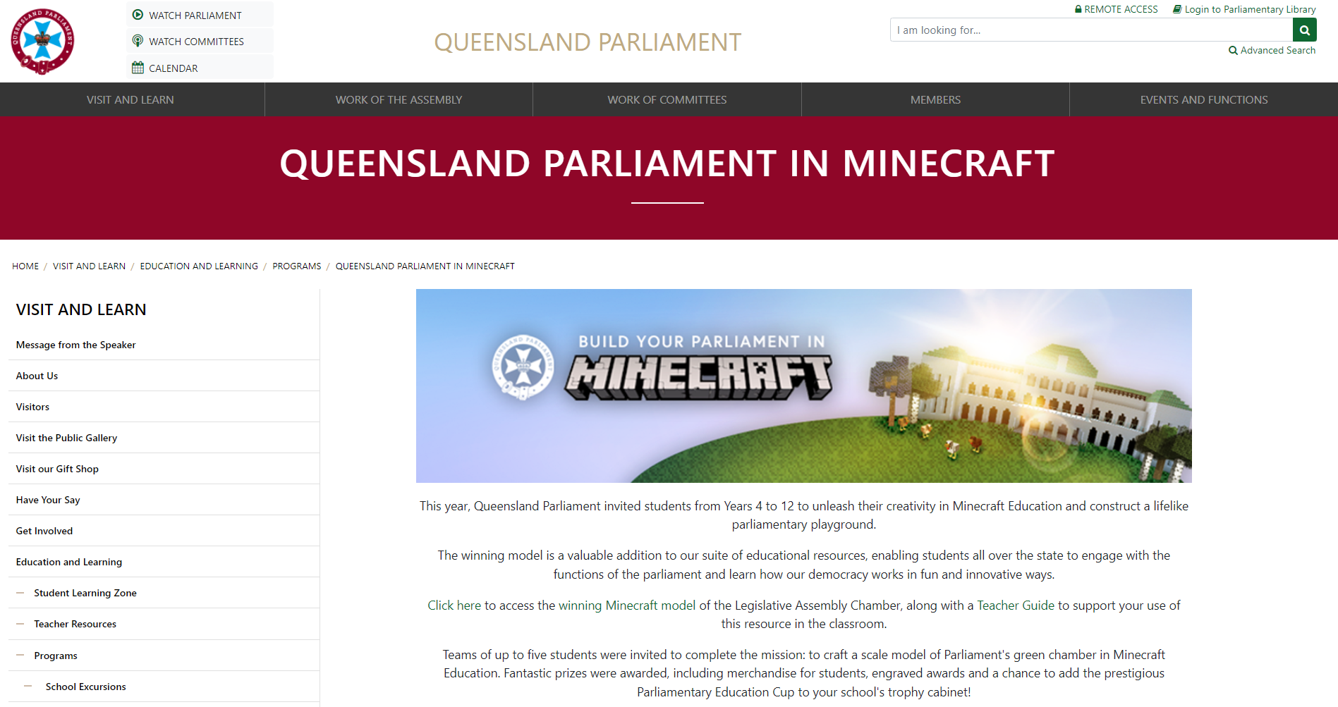
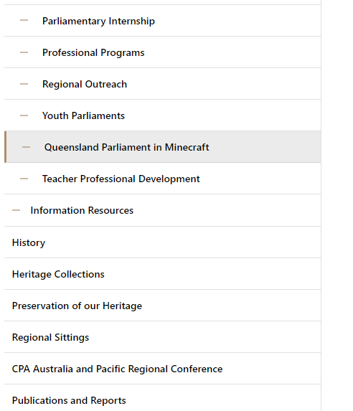
Turbocharging CIVICS education
Information and resources
Analytics:
2,529 page views
1,522 active users
8,469 event count
Learning objective: To view the location of competition information and resources

Slide 12
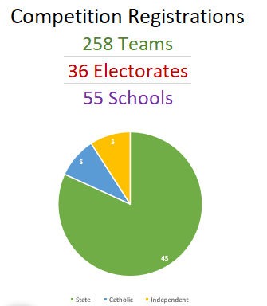
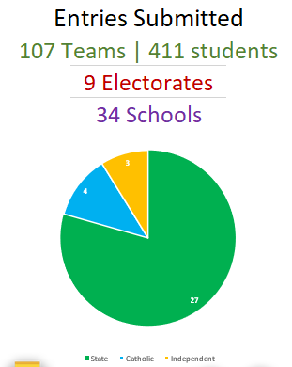
Turbocharging CIVICS education
Engagement statistics
34% increased engagement
reached 1,290 students across the state who might not otherwise have participated in civics education
Learning objective: To view the statistics on engagement and follow-through of registered teams

Slide 13
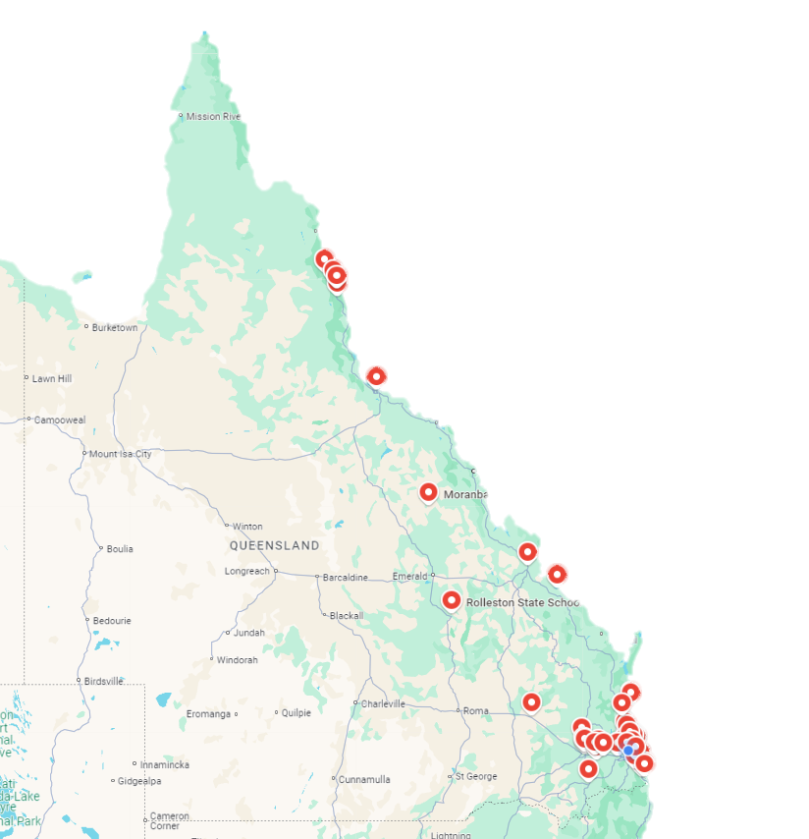
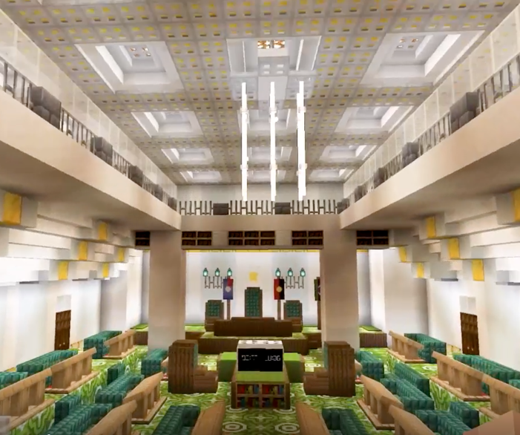
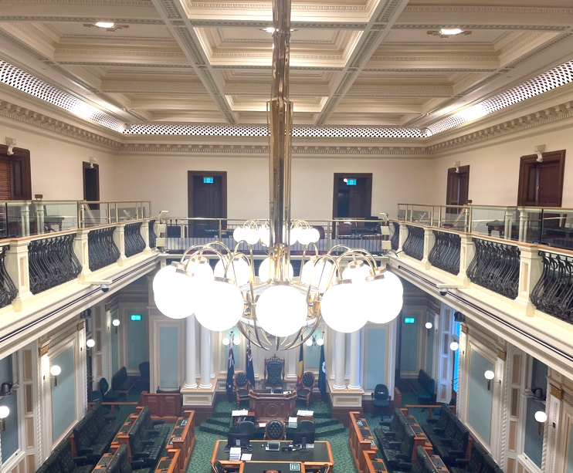
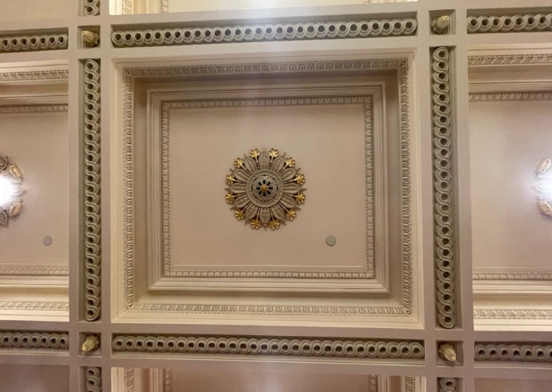
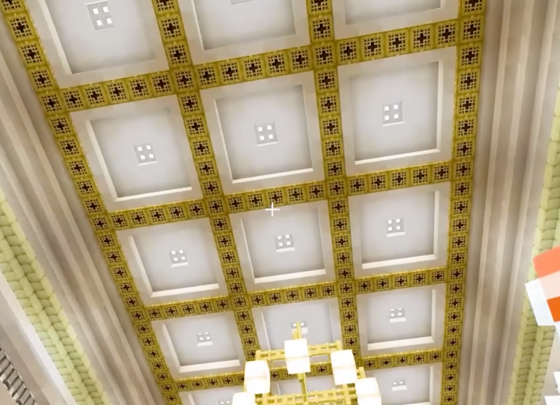
Turbocharging CIVICS education
Schools registered
Learning objective: To demonstrate the attention to detail required for success in the competition

Slide 14
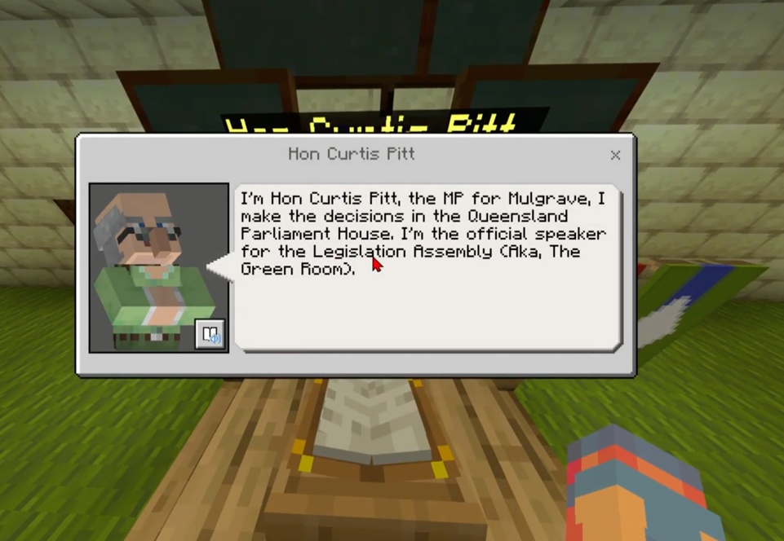
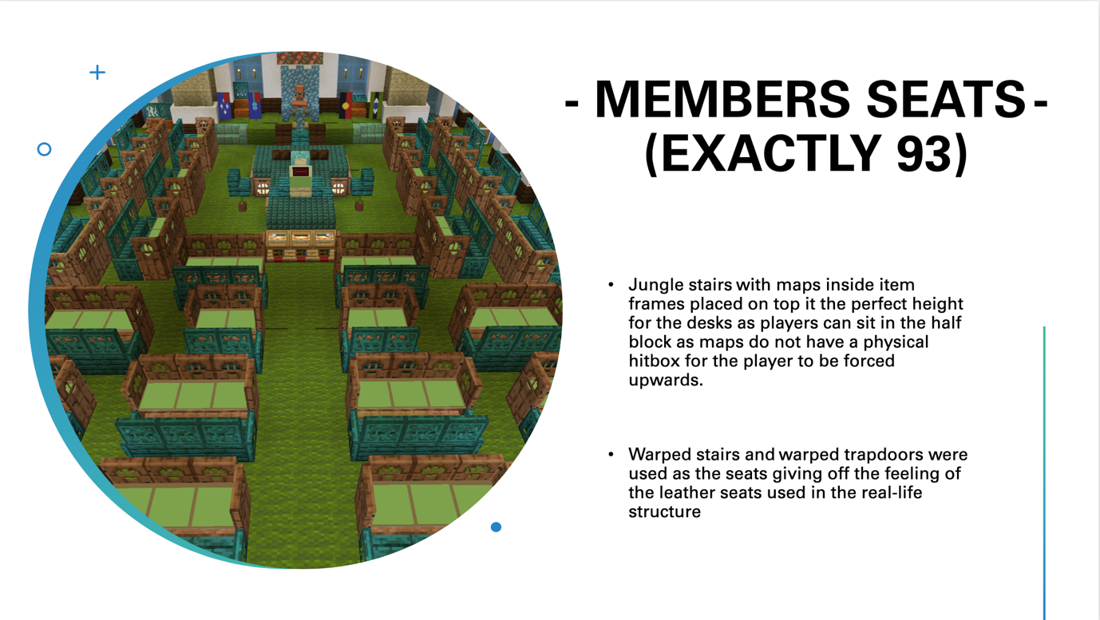
Turbocharging CIVICS education
Learning objective: To understand the importance of students documenting and reflecting on the building process

Slide 15
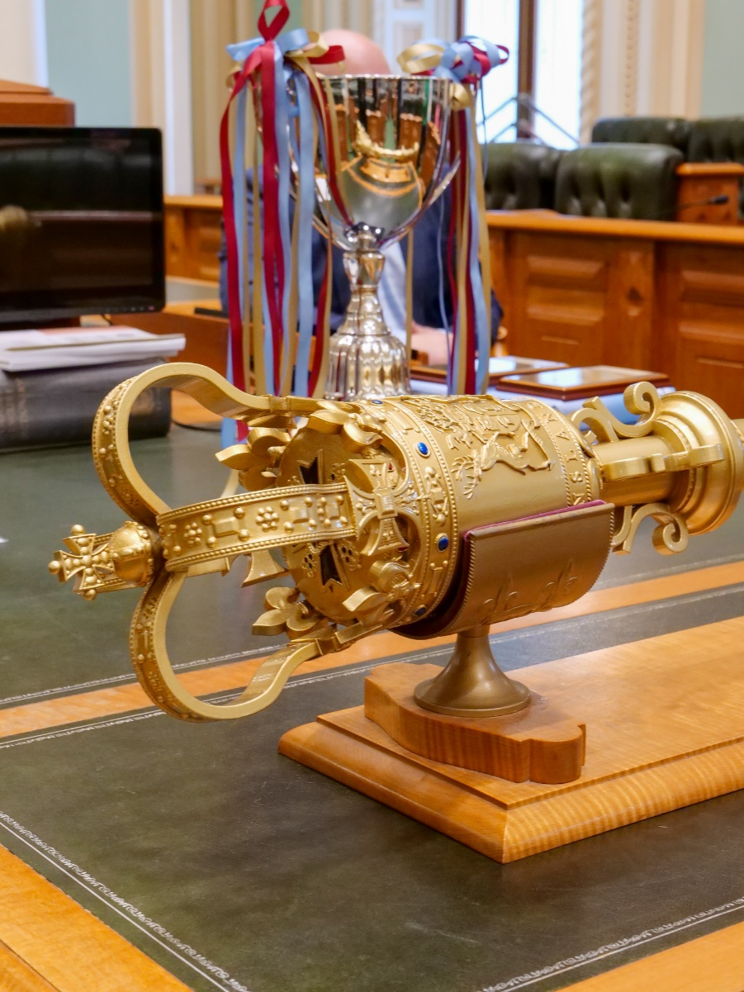
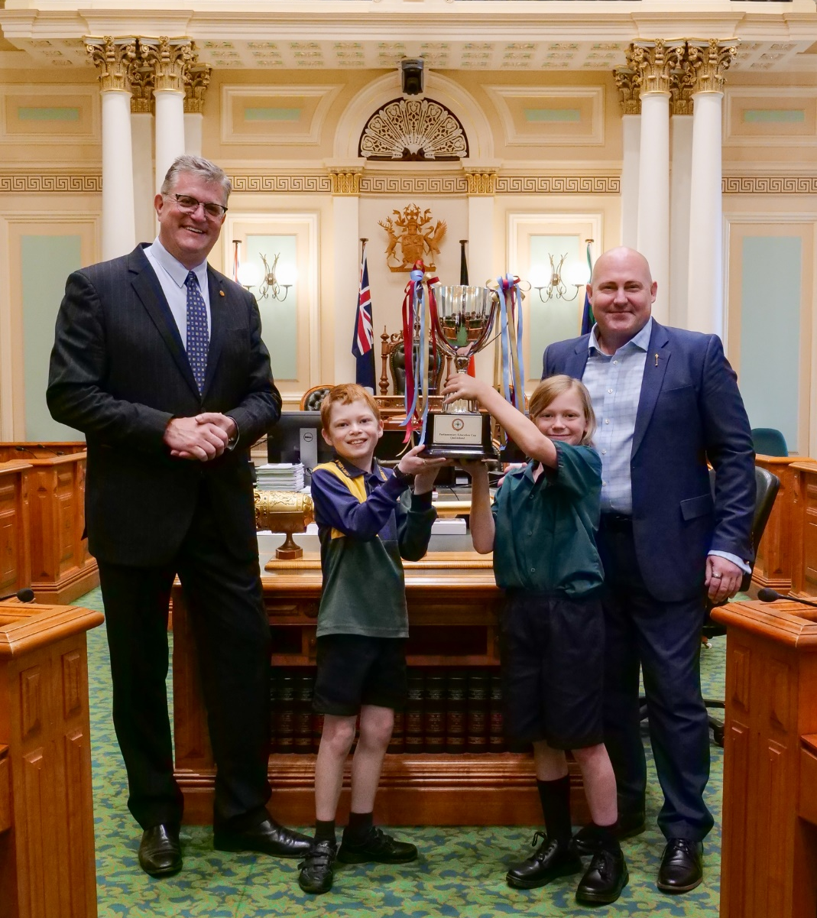
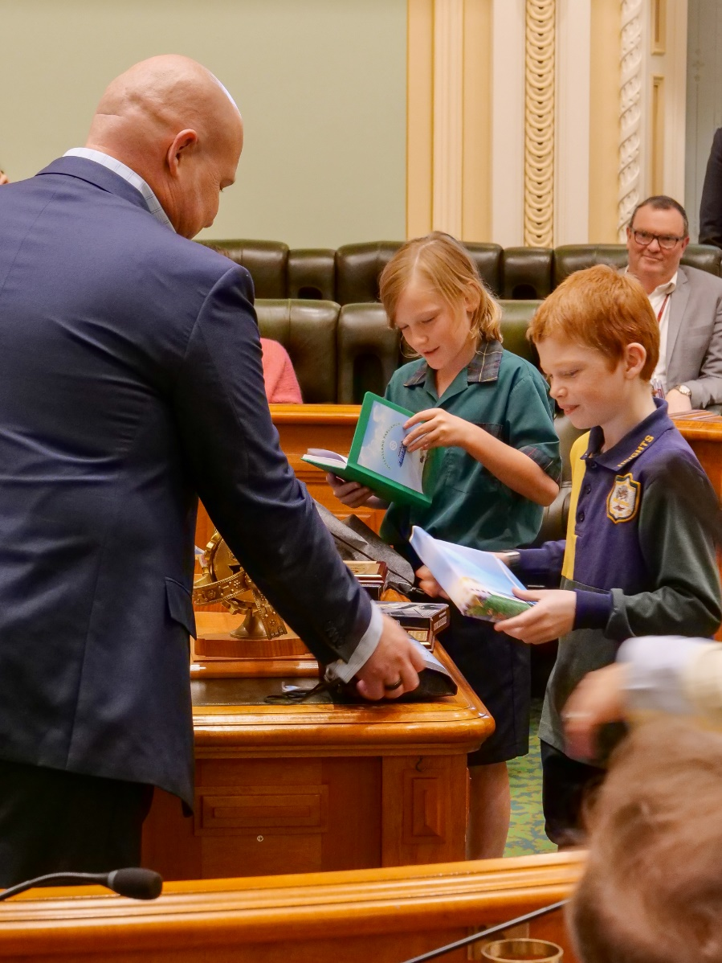
Turbocharging CIVICS education
Learning objective: To view the winners’ prize presentation

Slide 16
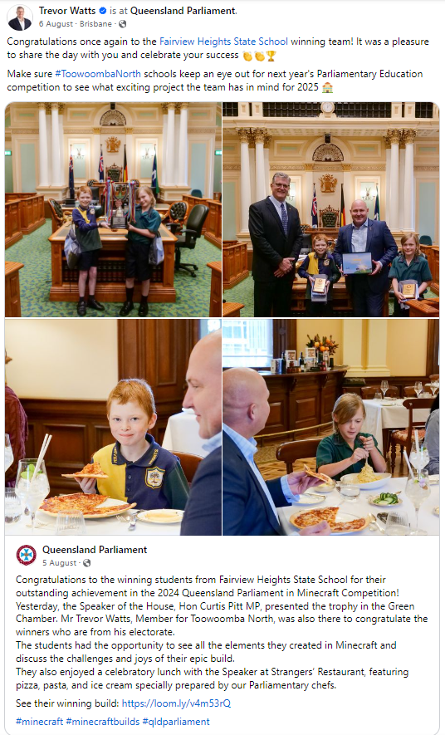
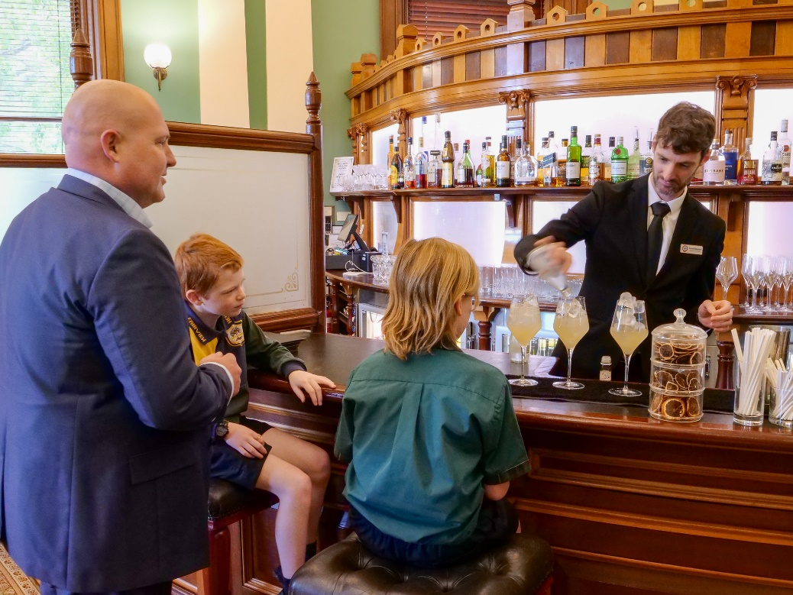
Turbocharging CIVICS education

Slide 17
Turbocharging CIVICS education
Building the Green Chamber gave us a chance to learn a lot about it as well!
Student testimonials
We never knew much about the legislative assembly chamber but this experience has made it so we always knew it!
When working in teams you need to make sure everyone’s voice is heard. We decided to settle on an idea with a democratic vote; majority rules.
We have enjoyed working out the scale and learning to cooperate as a team.
We would like to request another Minecraft challenge because we loved this one. Our favourite part was the teamwork.
As a group we had to make crucial decisions. Team members each had their own ideas, it was hard to pick just one.
We assigned jobs to each member to help get everything done, although we did end up working as a group due to the enjoyment of being able to collaborate
Our team learnt that communication is key to success
Learning objective: To review more of the students’ comments about participation in the competition.

Slide 18
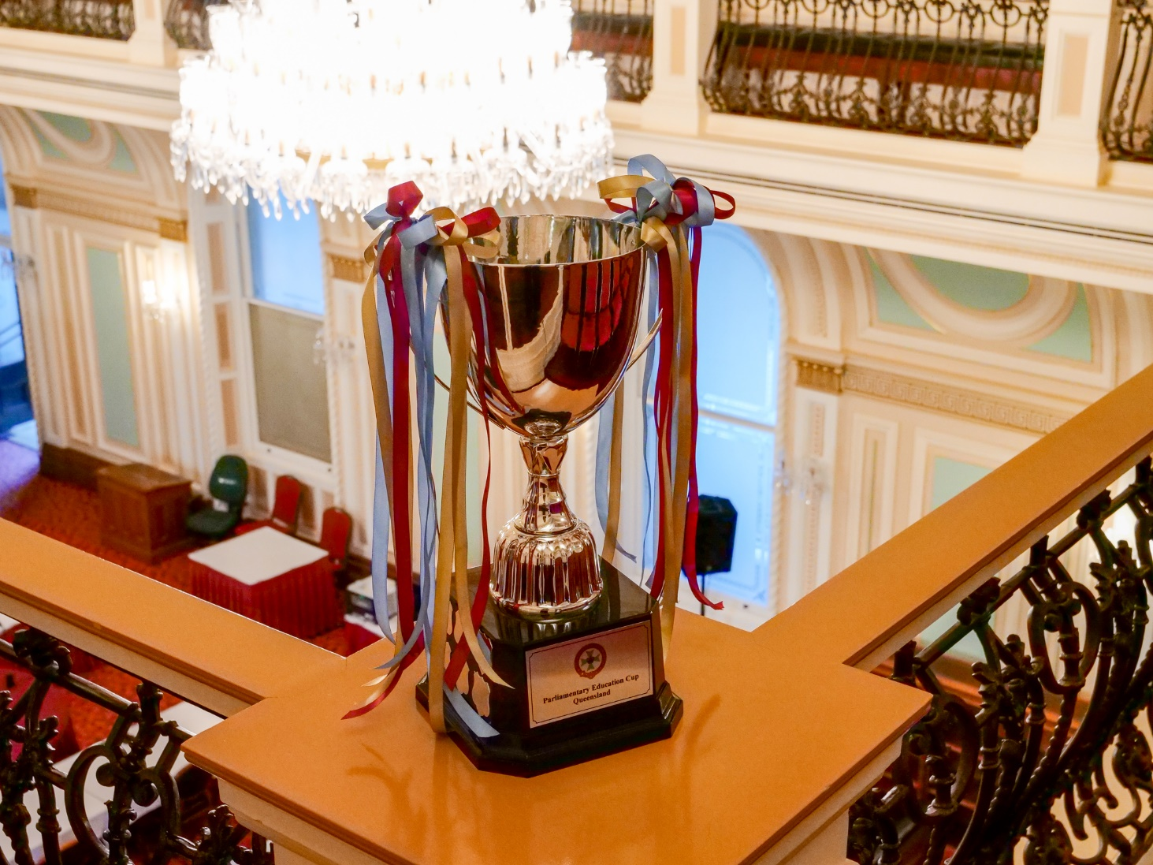
Turbocharging CIVICS education
2025 Parliamentary Education Cup
Build the Red Chamber in Minecraft Education
Learning objective: To explain the next steps for the Parliamentary Education Cup

Slide 19
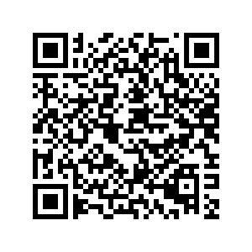
Turbocharging CIVICS education
Contact us
www.parliament.qld.gov.au/Minecraft
Parliamentary.Education@parliament.qld.gov.au
+61 7 3553 6413
Maria Mead
Parliamentary Education Officer

